Slide 1
Deep analysis of the major differences in Fire Emissions products between G16 and G19 during the period from April 2 to April 4, 2025.

Slide 2
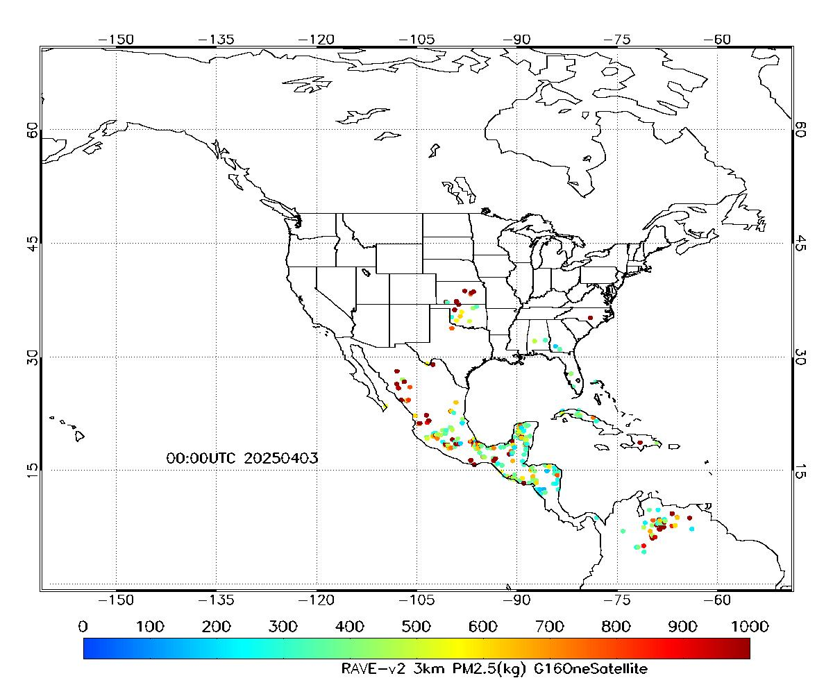
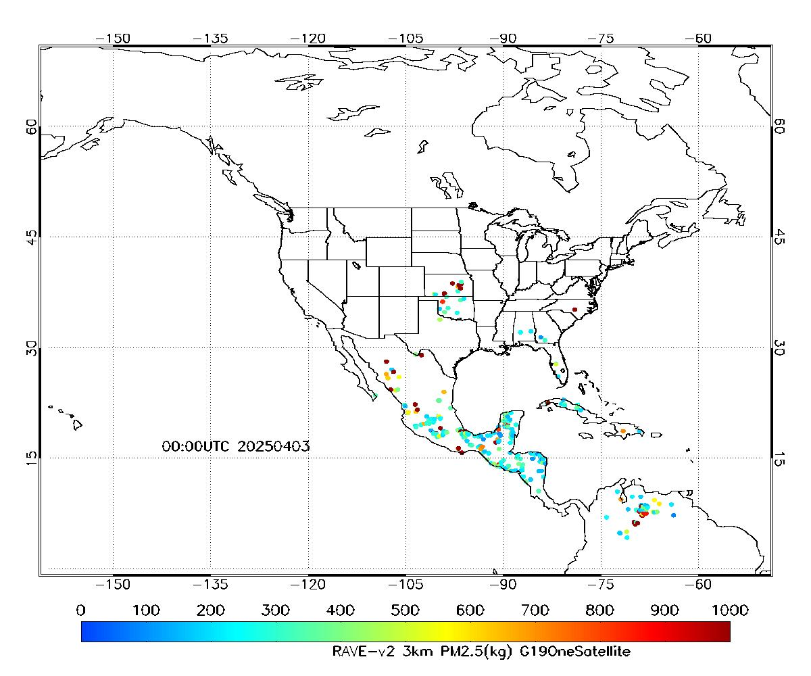
Control tests for the RAVE system use only G16 or G19 data, without input from other satellites. The objective is to eliminate the influence of other satellite data.
Only using G16 data
Only using G19 data
Nearly identical spatial distribution patterns, but a larger difference in value magnitude

Slide 3
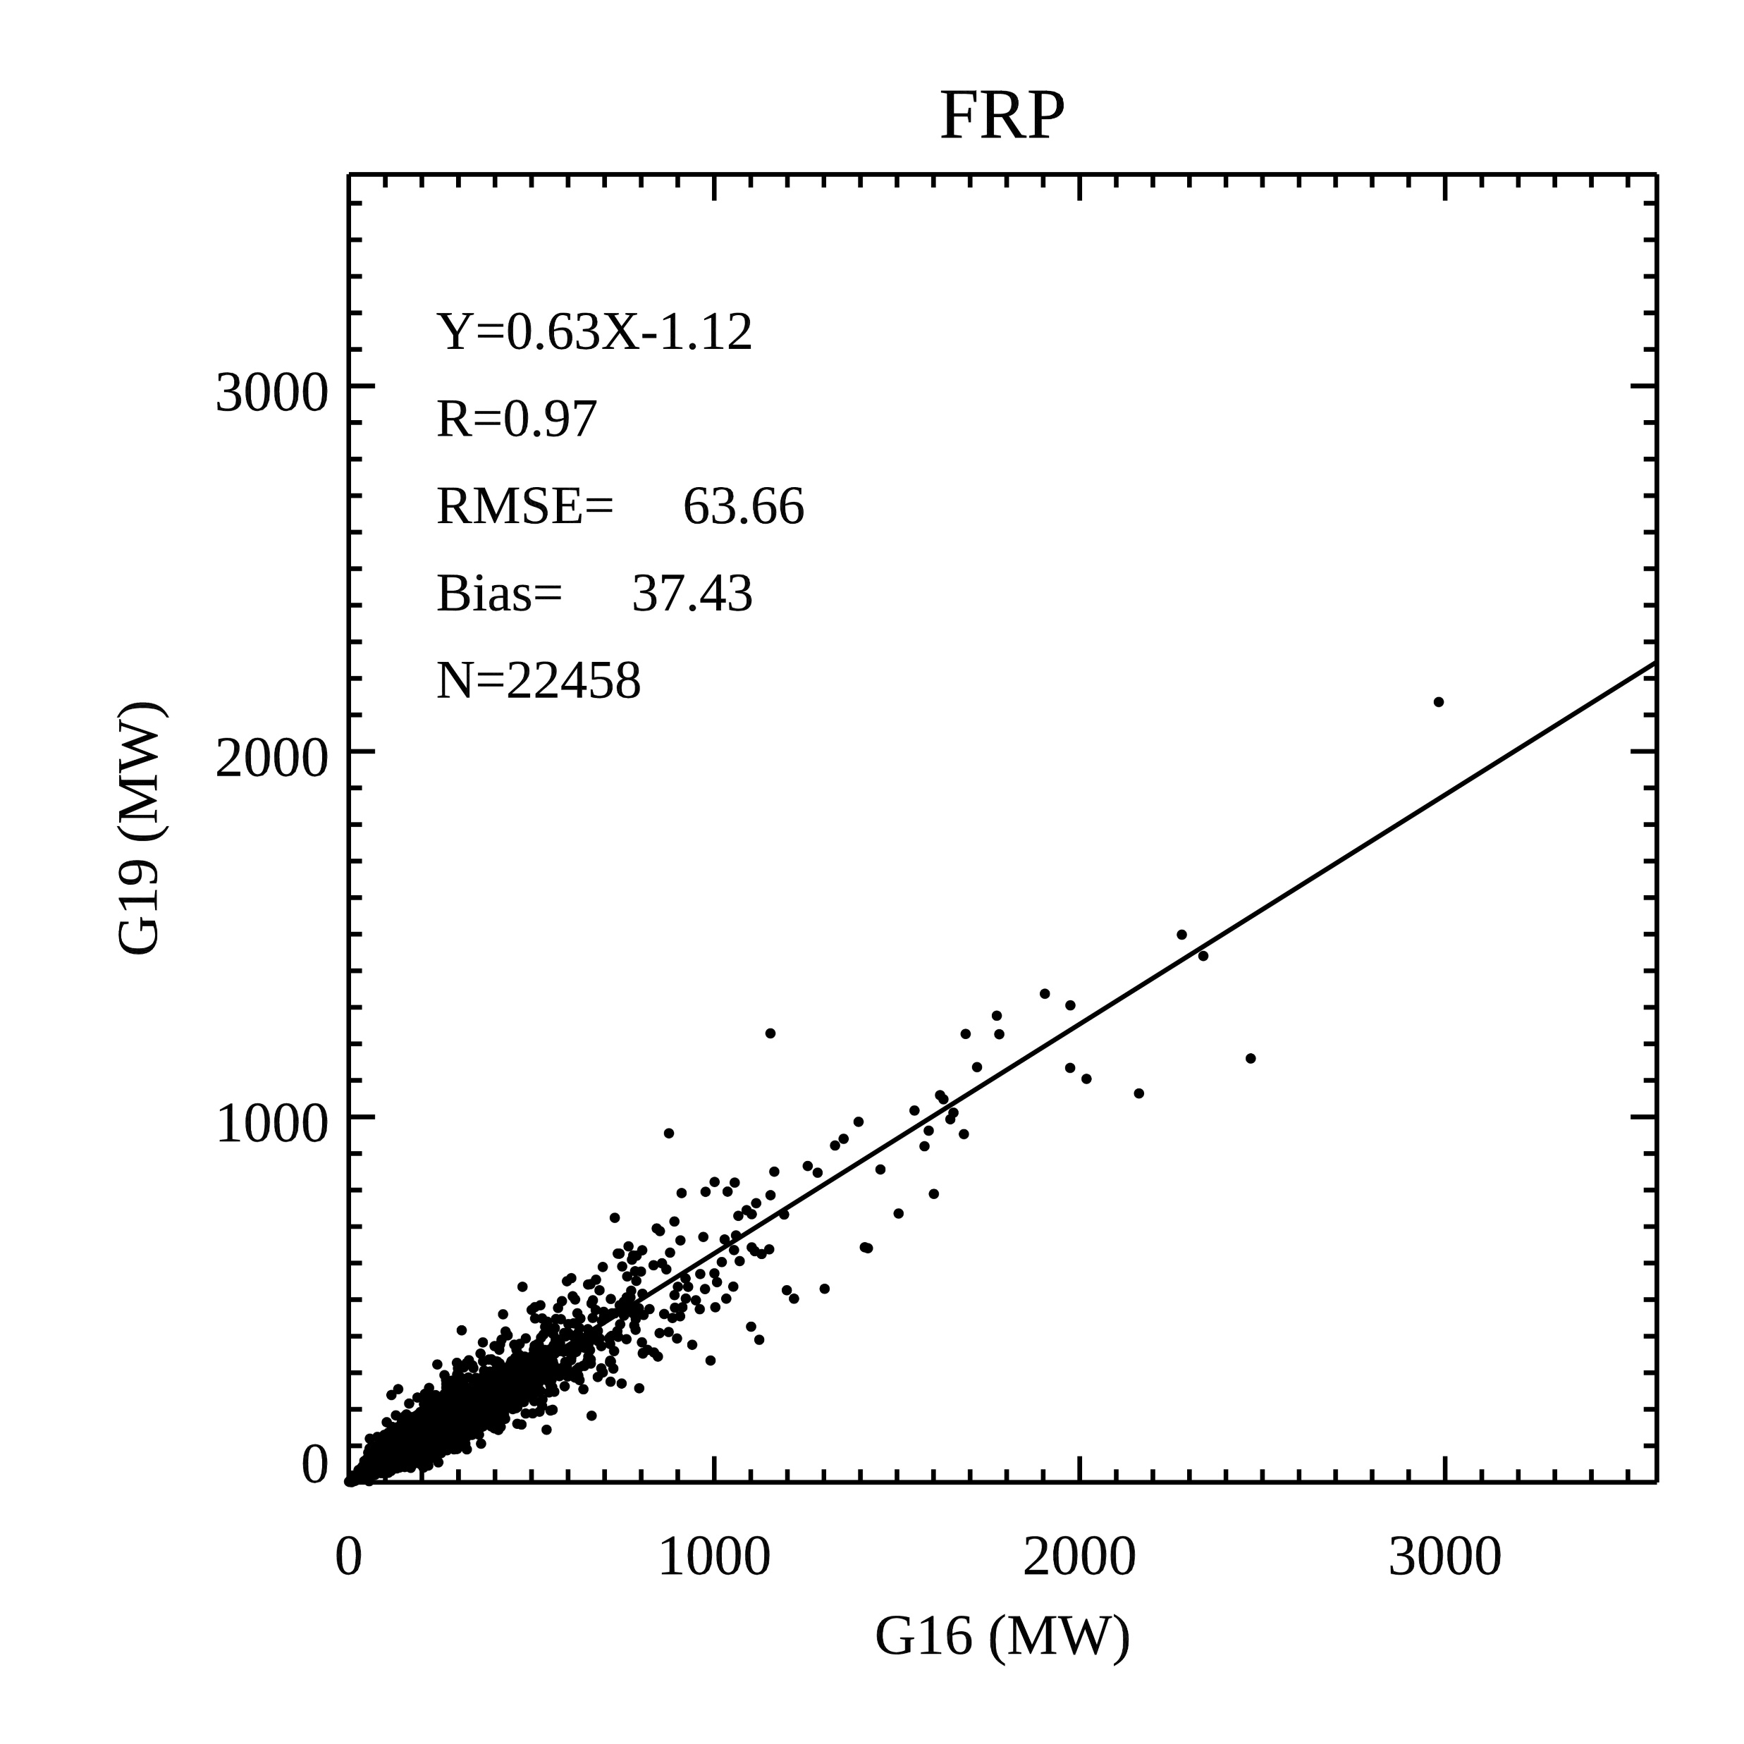
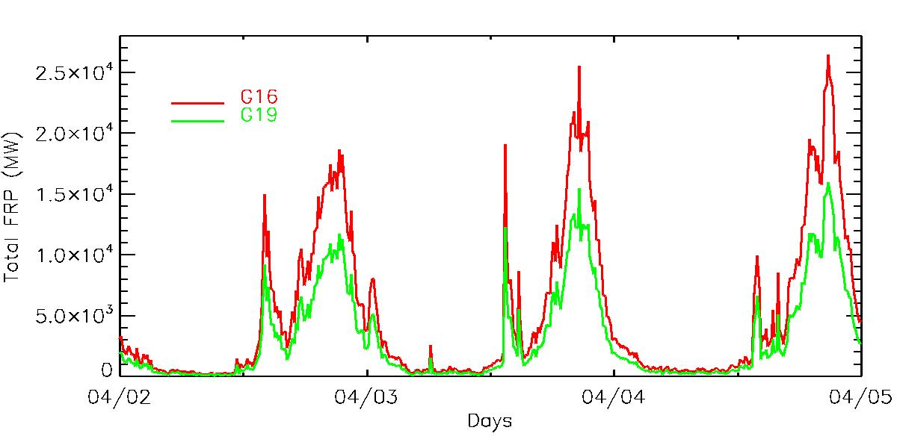
Raw FRP data analyses : G16 vs G19
Total accumulated FRP Accumulation across entire domain
Pixel level
Analyses of the raw FRP from G16 and G19 FDC files further confirm that both satellites retrieve nearly identical spatial distribution patterns; however, the magnitude of the value difference is larger than expected.

Slide 4
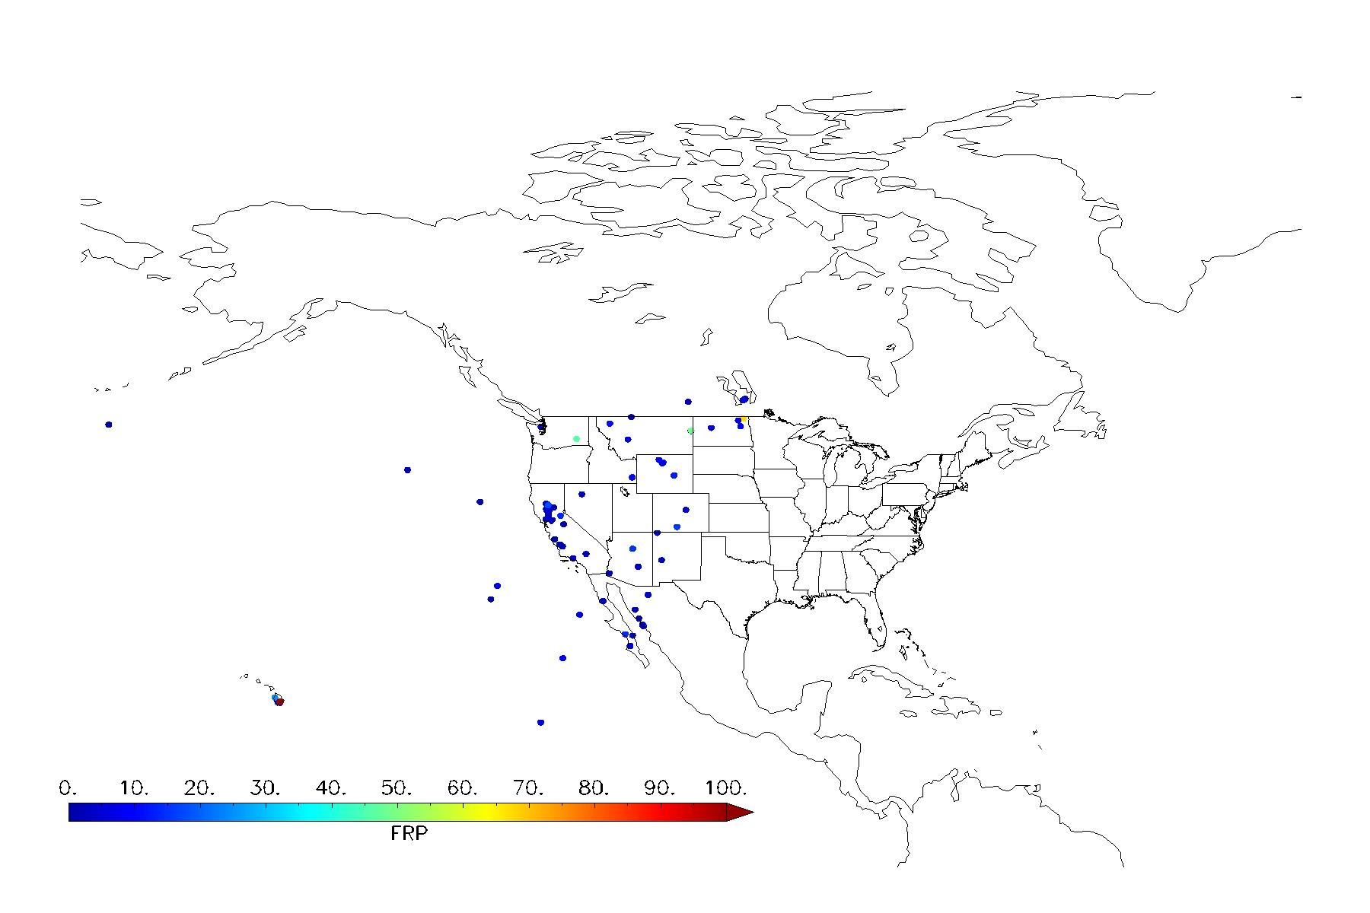
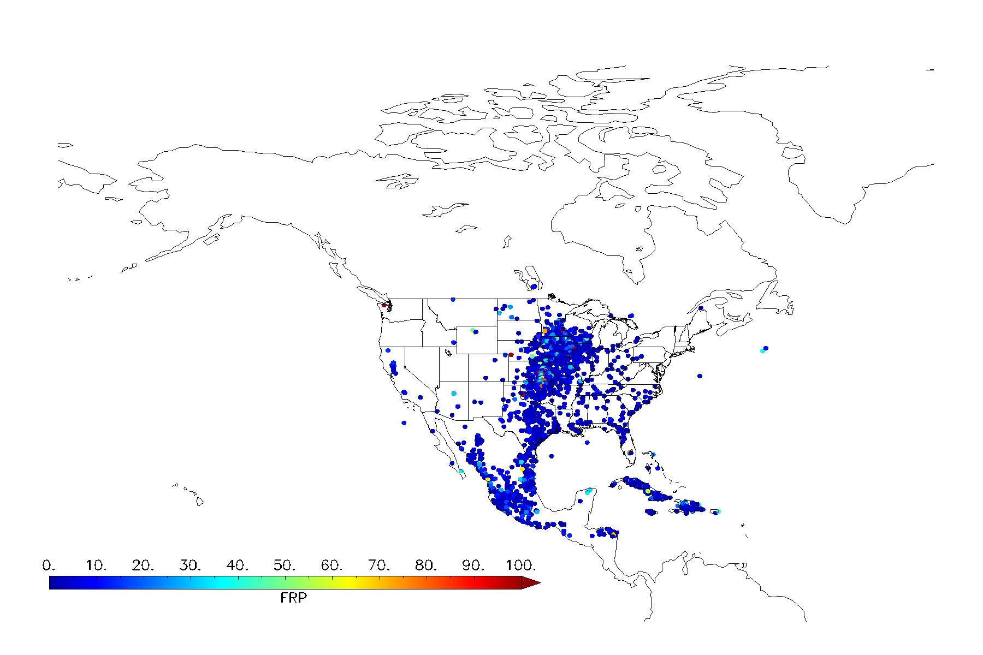
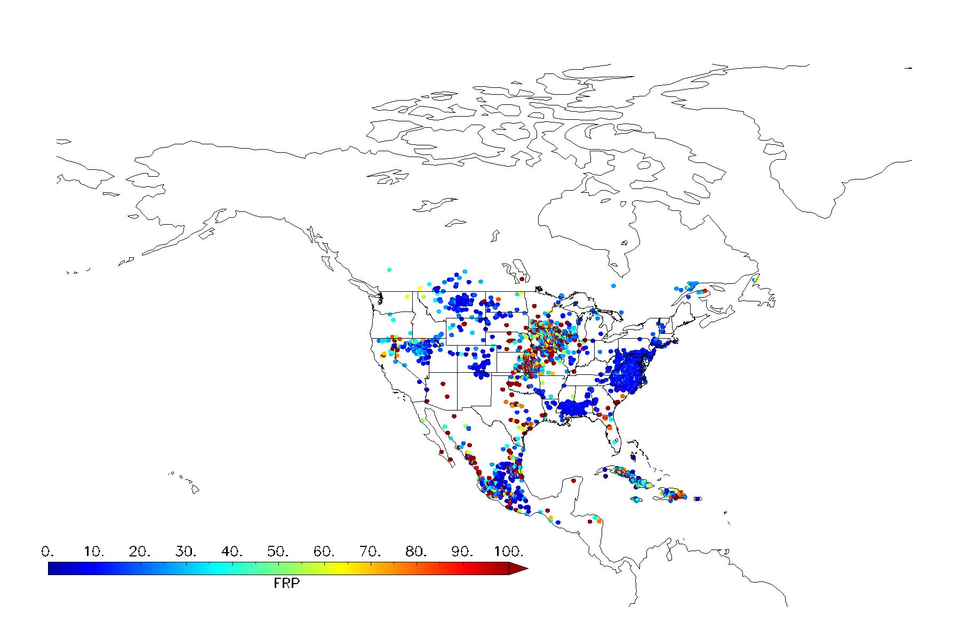
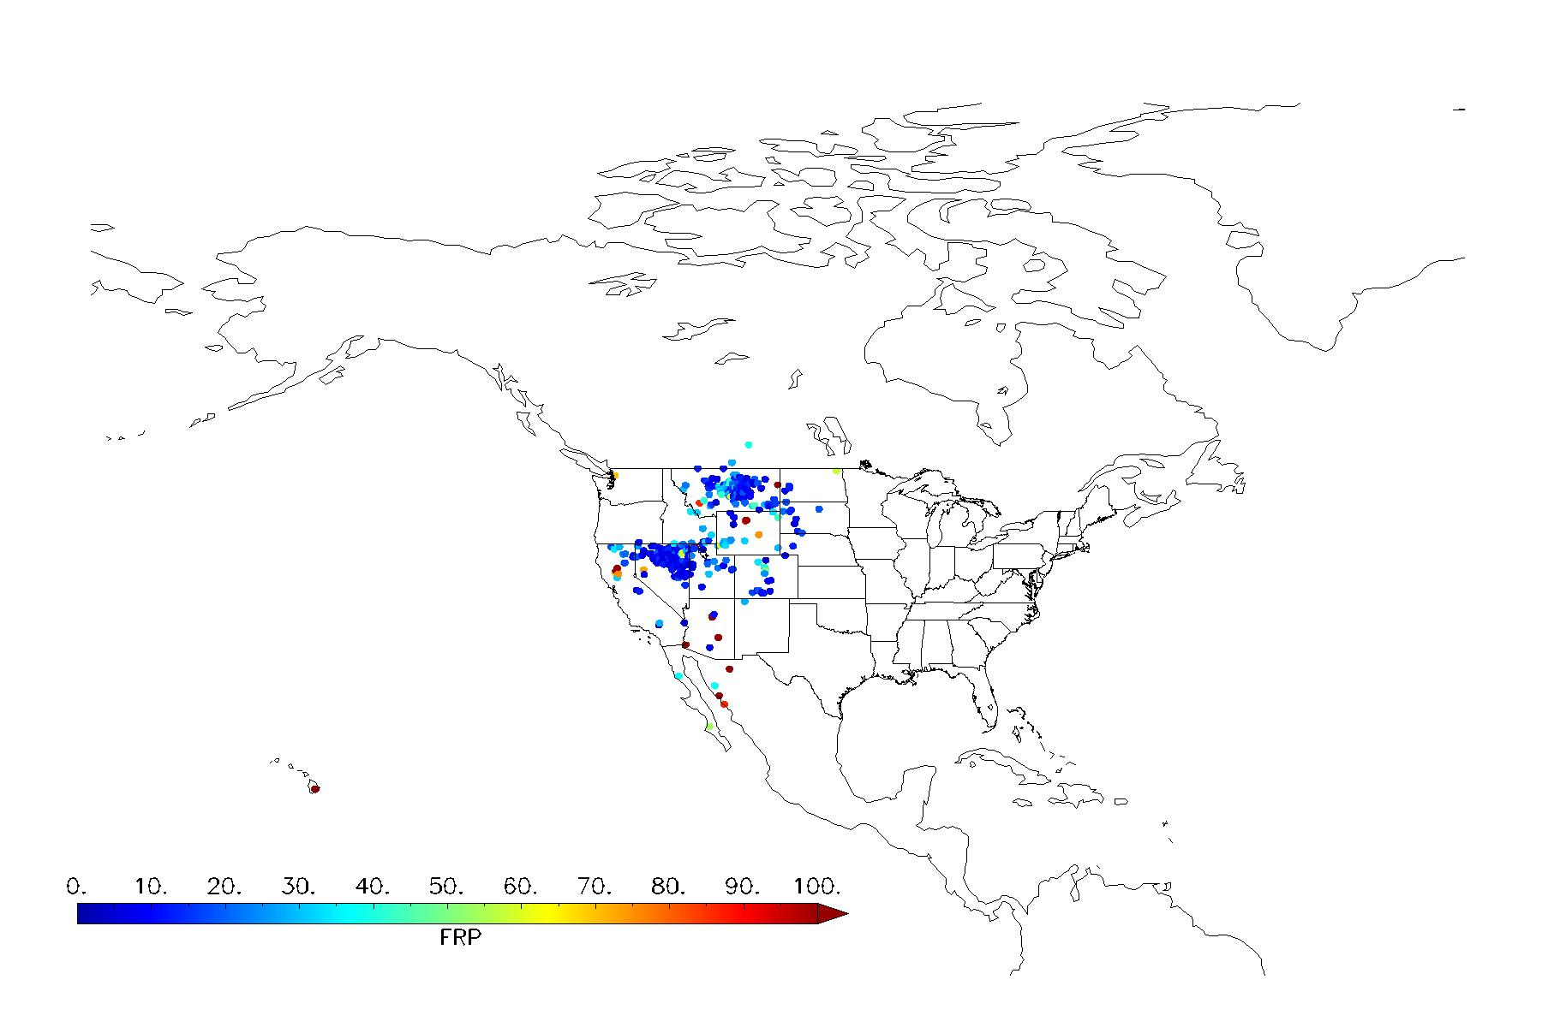
Application of NGFS fire product in fire emissions retrieval algorithm
FDCC product: 5-minute and CONUS data
Date: April 8, 2025
GOES-18
GOES-19
NGFS
NGFS
All available hotspot pixels over the CONUS
Current operational product
Current operational product

Slide 5
Investigation of an issue with the Error Warning (Red Status) for RAVE Operational Products on April 10, 2025
No validated FRP values across the entire domain, which may have been due to problems with the input data;
Experiencing data outages for G18/G19, including ABI FDC;
Not sure whether NOAA20/NOAA21 were affected. At least, unavailable over North America ;
Starting from 05Z, the data returned to normal.
IDL> READANDPLOTRAVEFIREEMISSIONAS
../GOES19outputfilesfromUAT/20250410/RAVE-HrlyEmiss-3km_v2r0_blend_s202504100000000_e202504100059590_c202504100202020.nc
% Loaded DLM: NCDF.
-1.00000
../GOES19outputfilesfromUAT/20250410/RAVE-HrlyEmiss-3km_v2r0_blend_s202504100100000_e202504100159590_c202504100301590.nc
-1.00000
../GOES19outputfilesfromUAT/20250410/RAVE-HrlyEmiss-3km_v2r0_blend_s202504100200000_e202504100259590_c202504100402010.nc
-1.00000
../GOES19outputfilesfromUAT/20250410/RAVE-HrlyEmiss-3km_v2r0_blend_s202504100300000_e202504100359590_c202504100502020.nc
-1.00000
../GOES19outputfilesfromUAT/20250410/RAVE-HrlyEmiss-3km_v2r0_blend_s202504100400000_e202504100459590_c202504100602050.nc
-1.00000
../GOES19outputfilesfromUAT/20250410/RAVE-HrlyEmiss-3km_v2r0_blend_s202504100500000_e202504100559590_c202504100701570.nc
21.2865 41.2317 16.1702 16.2834 14.7830 9.47853 50.1827 27.9865 10.4593 6.49217 14.8467 93.8733 23.0735 22.7226 8.94866
4.98024 8.94866 35.0928 31.4081 2.89516 2.71969 26.1689 23.1612 32.9872 9.65052 15.0899 7.39004

Slide 6
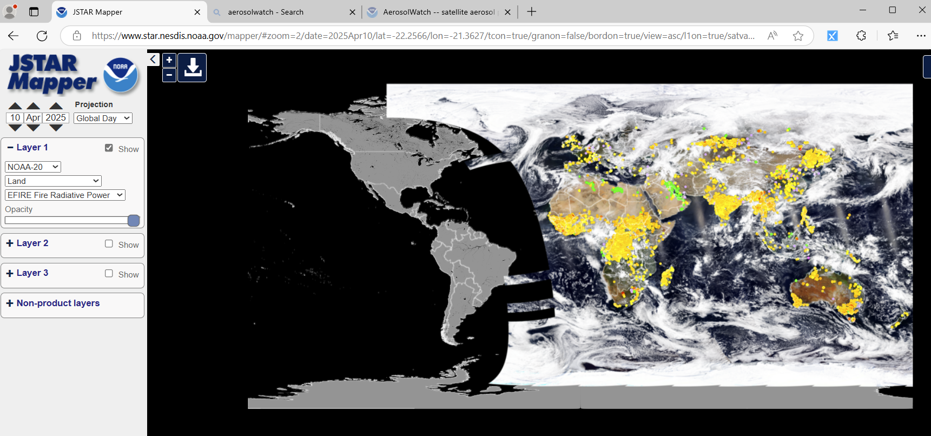
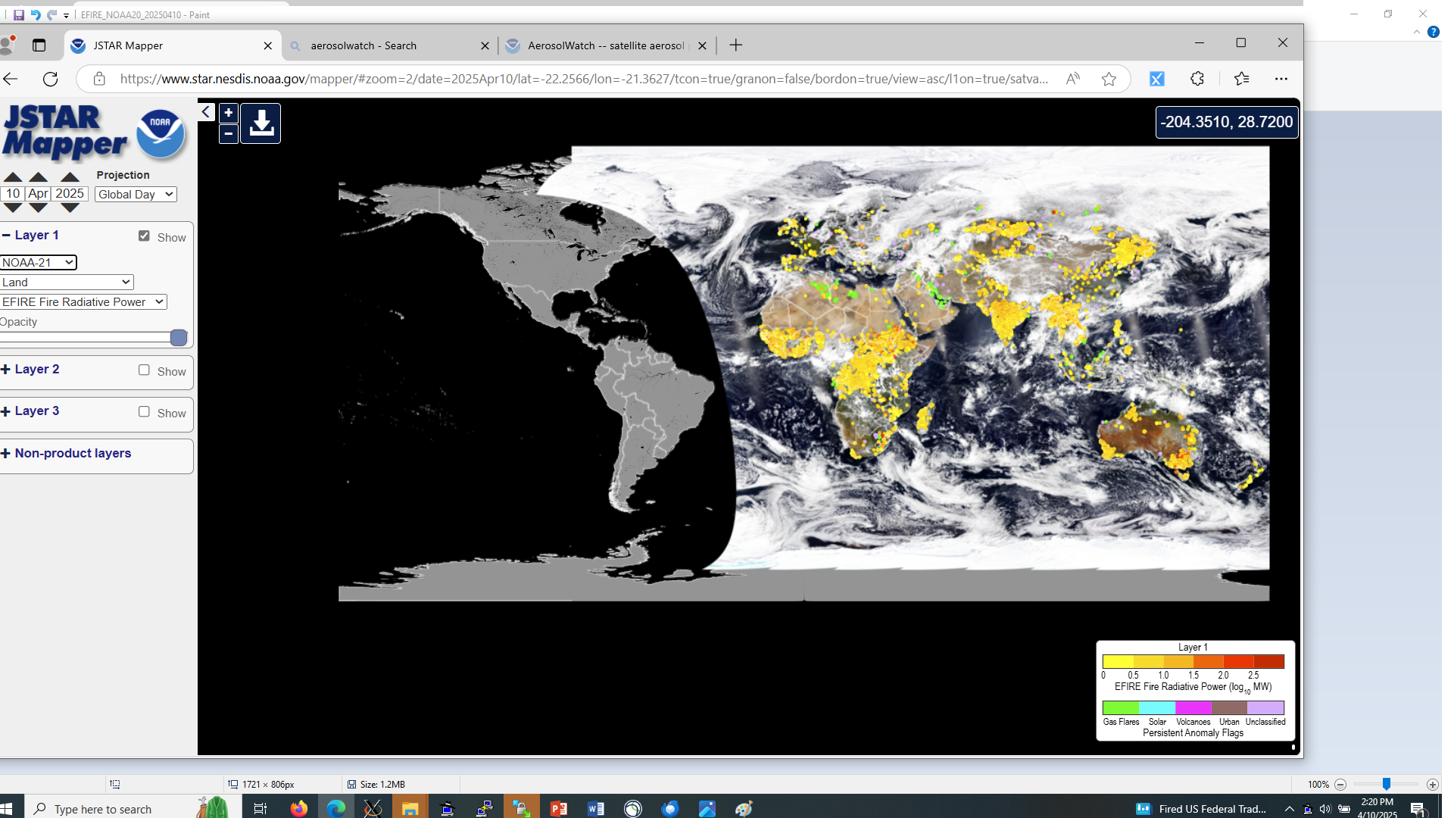
Reason: No VIIRS fire products were available across North America, and there were data outages for G18 and G9 from 00Z to 04Z.

