Slide 1
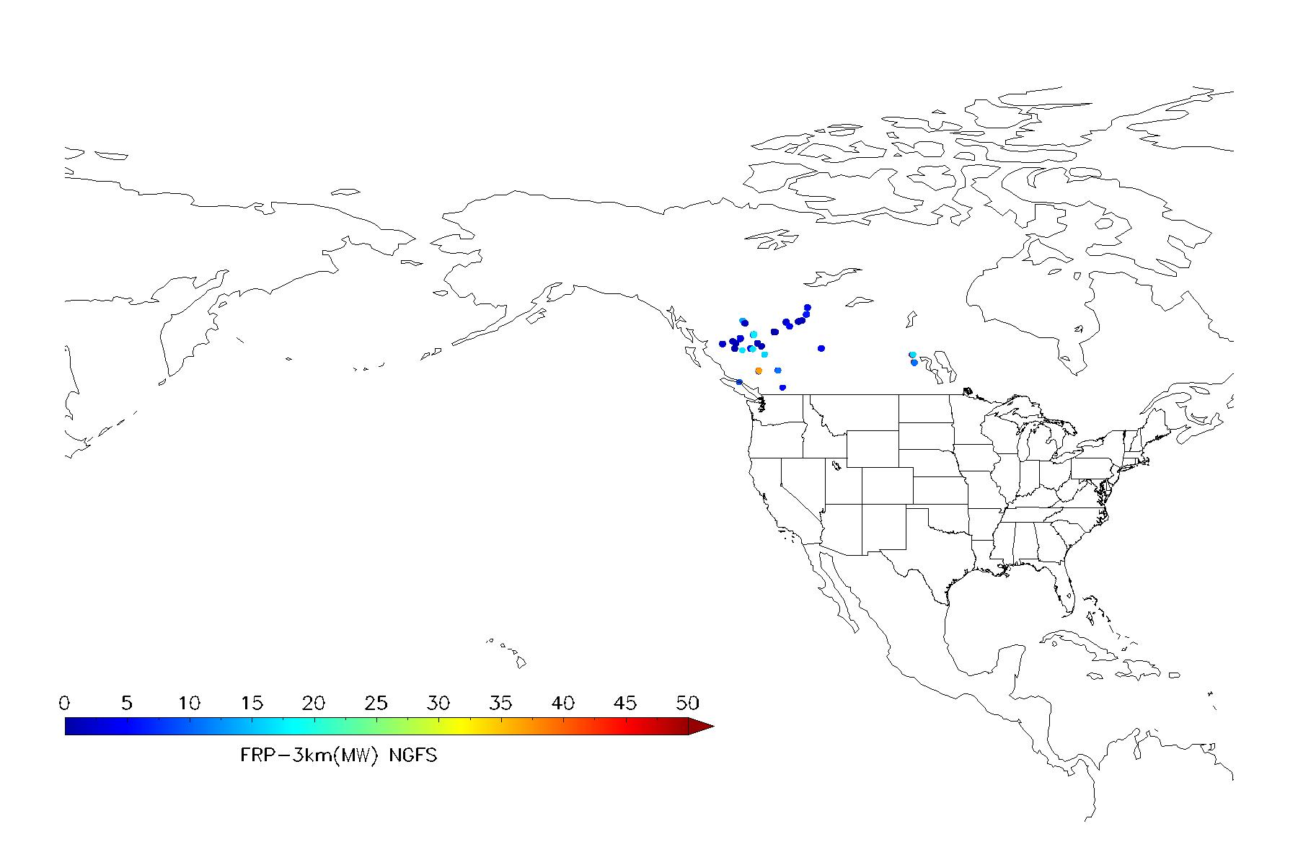
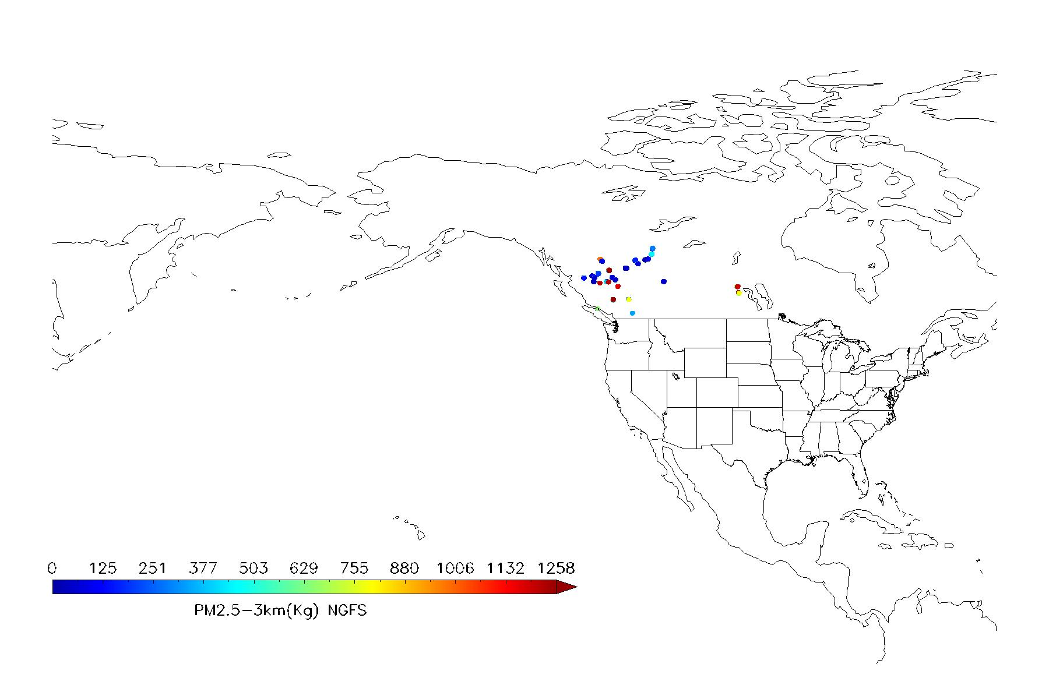
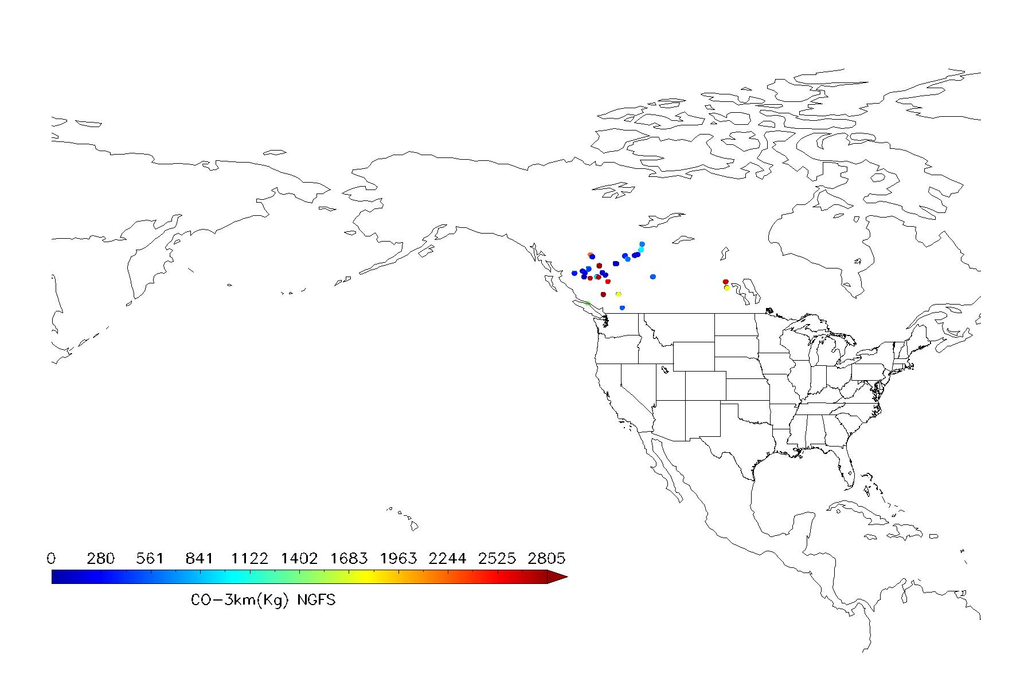

Successfully run RAVE algorithm with new NGFS FRP (GOES18-FD) and output fire emissions
Example: 18:00UTC 20231112
FRP
PM2.5
CO
CH4

Slide 2
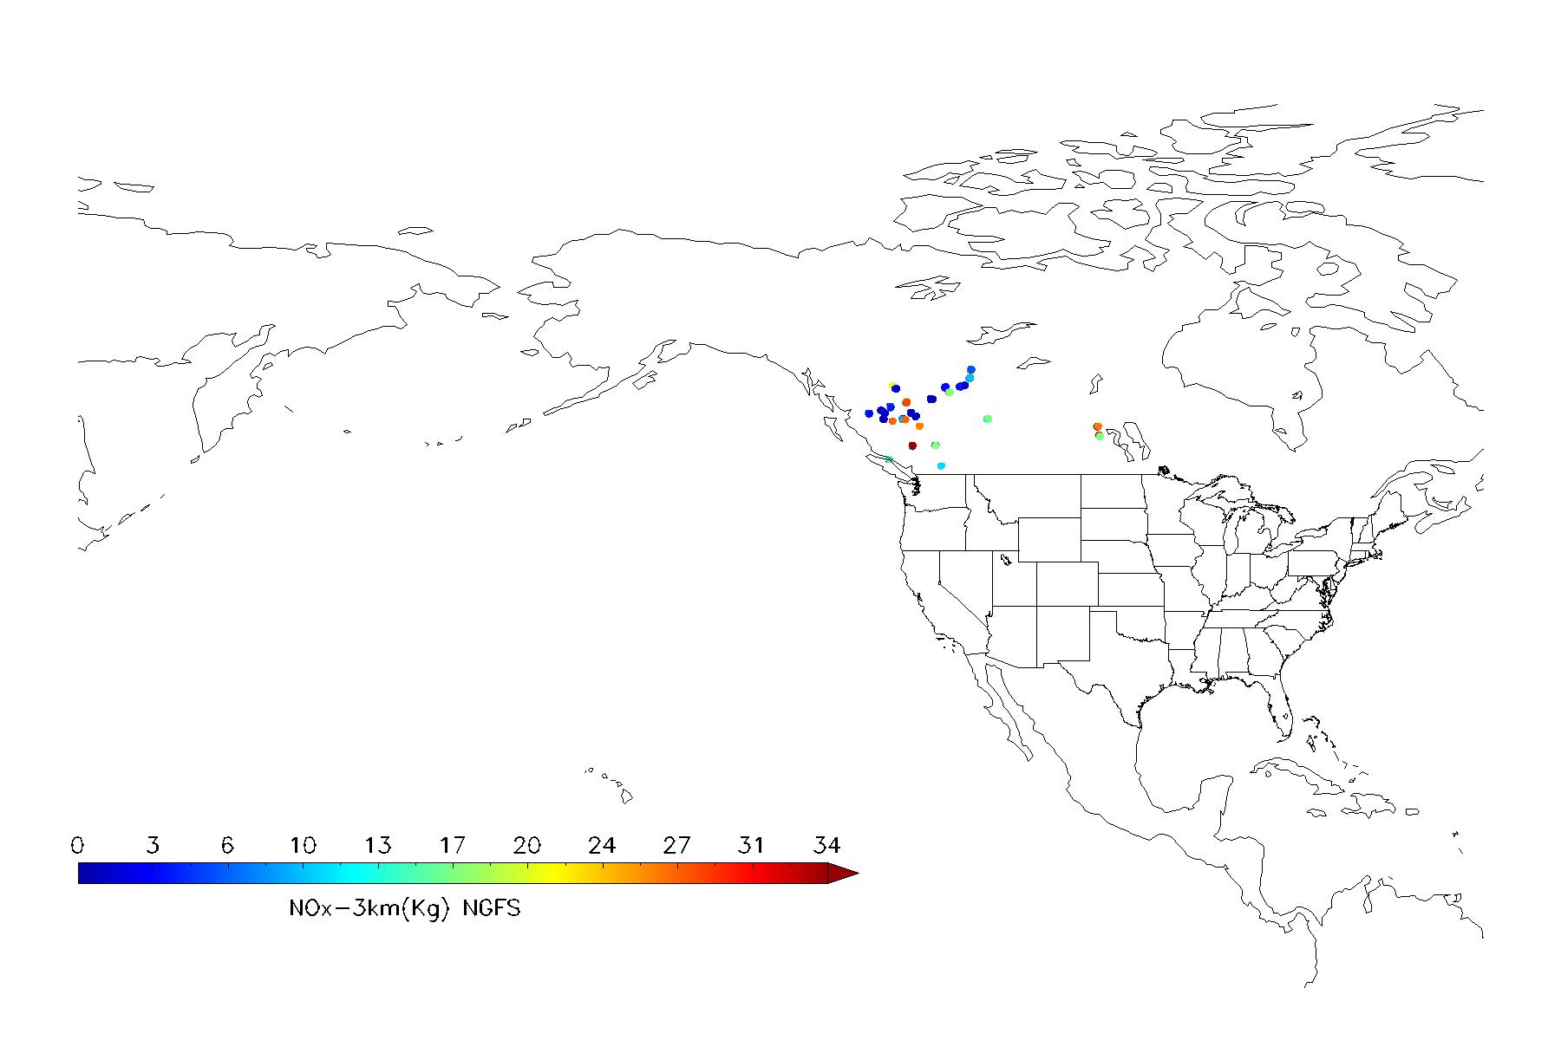

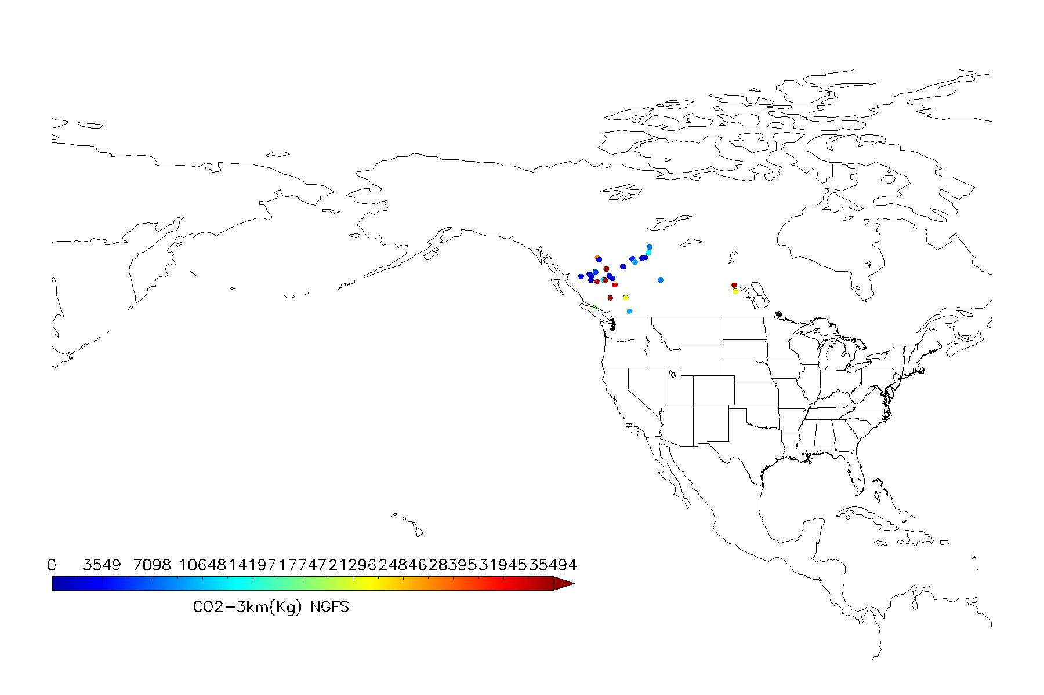

18:00UTC 20231112
NOx
BC
CO2
SO2

Slide 3
Re-organize the current NGFS CONUS 5-minute data
Collocate spatial data from the CONUS sector to the full-disk dataset.
the pixel location (Lat/Lon) in GOES CONUS data does not directly correspond to the same pixel position in the GOES Full Disk image. The CONUS image is a subset of the Full Disk, but it has its own grid and coordinates, and is not just a "crop" from the Full Disk array.
Merge two 5-minute files into a single 10-minute file.
Sketch chart

Slide 4
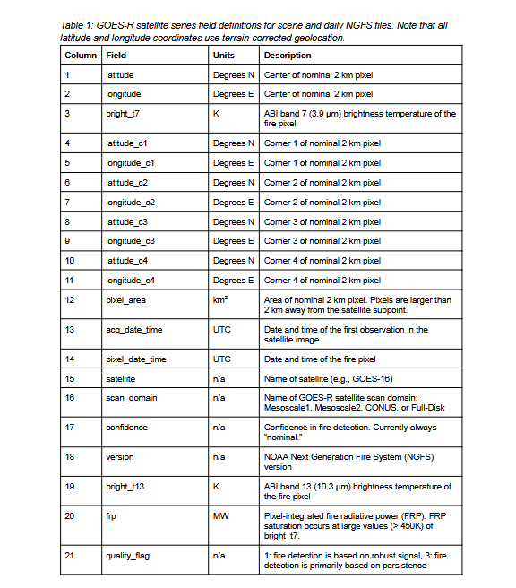
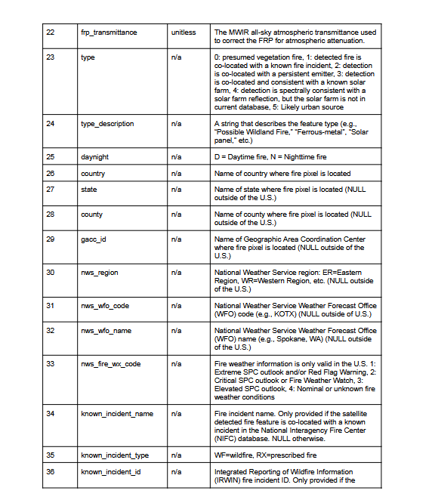

Slide 5
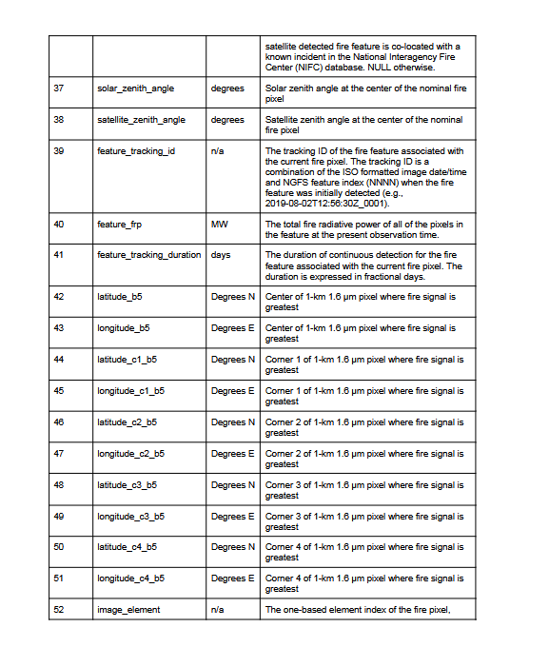
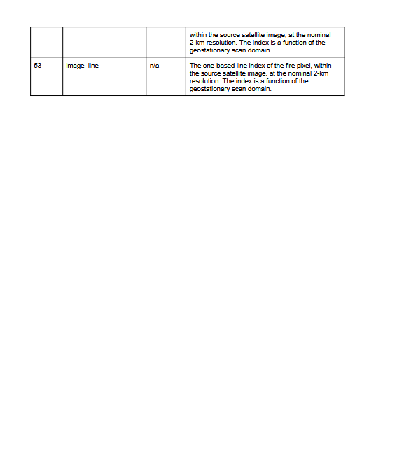

Slide 6
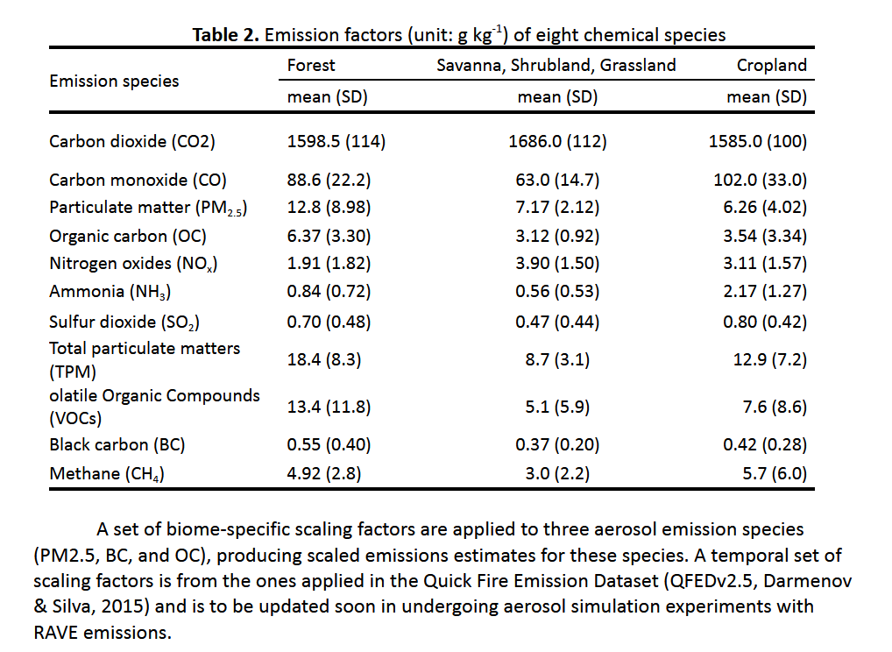

Slide 7
Data question: FRP values are valid but Temperature and Mask contain fill values ?
AREA UINT = Array[5424, 5424]
TEMP UINT = Array[5424, 5424]
MASK INT = Array[5424, 5424]
FRP FLOAT = Array[5424, 5424]
QA BYTE = Array[5424, 5424]
X INT = Array[5424]
Y INT = Array[5424]
3088, 305 157.576, 0, 65535, 65535, 33
3283, 470 112.825, 0, 65535, 65535, 33
3301, 467 97.5756, 0, 65535, 65535, 33
3722, 414 66.4364, 0, 65535, 65535, 33
3827, 1048 35.8389, 0, 341, 1730, 30
../G18FDCData/OR_ABI-L2-FDCF-M6_G18_s20233160010203_e20233160019511_c20233160020017.nc
AREA UINT = Array[5424, 5424]
TEMP UINT = Array[5424, 5424]
MASK INT = Array[5424, 5424]
FRP FLOAT = Array[5424, 5424]
QA BYTE = Array[5424, 5424]
X INT = Array[5424]
Y INT = Array[5424]
3088, 305 183.760, 0, 65535, 65535, 33
3283, 470 95.7953, 0, 65535, 65535, 33
3301, 467 87.6316, 0, 65535, 65535, 33
3698, 392 76.2961, 0, 65535, 65535, 33
3722, 414 65.3991, 0, 65535, 65535, 33

