Slide 1
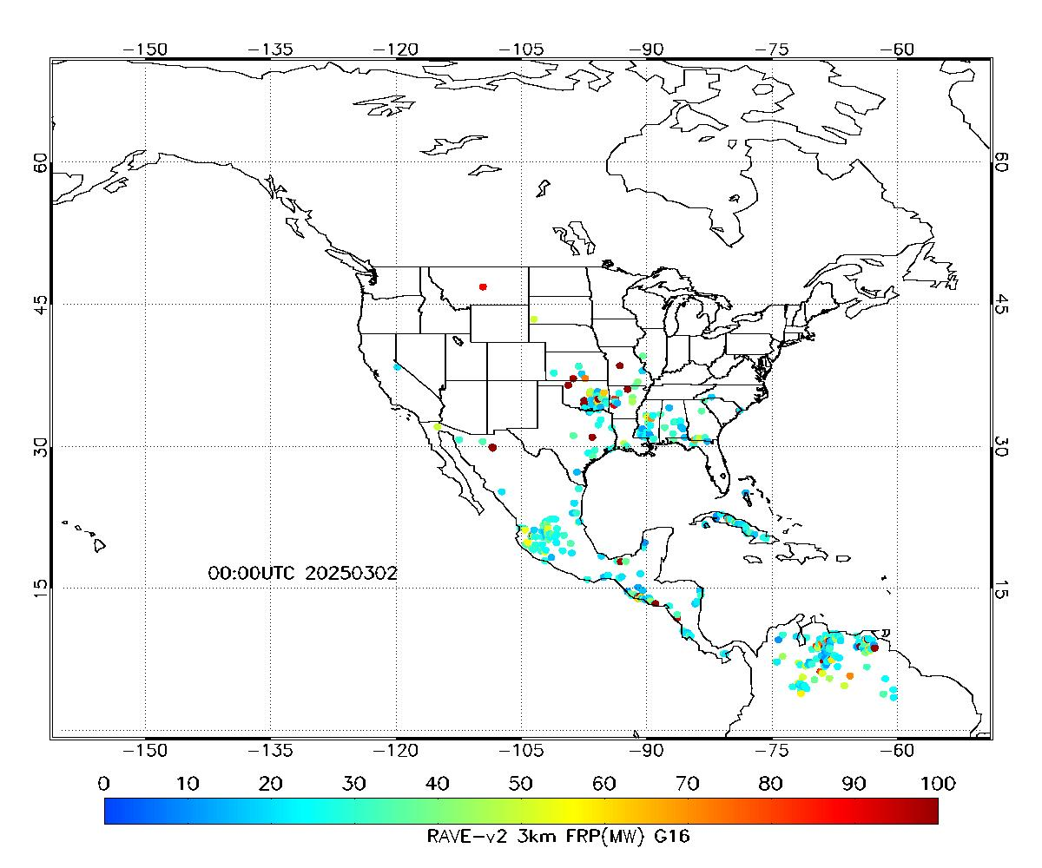

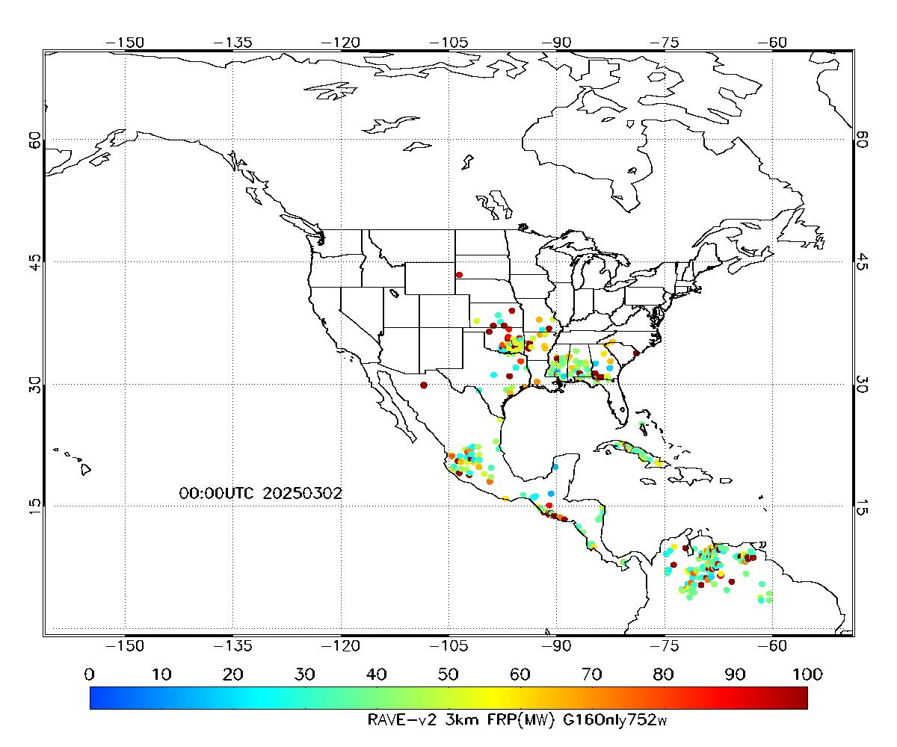
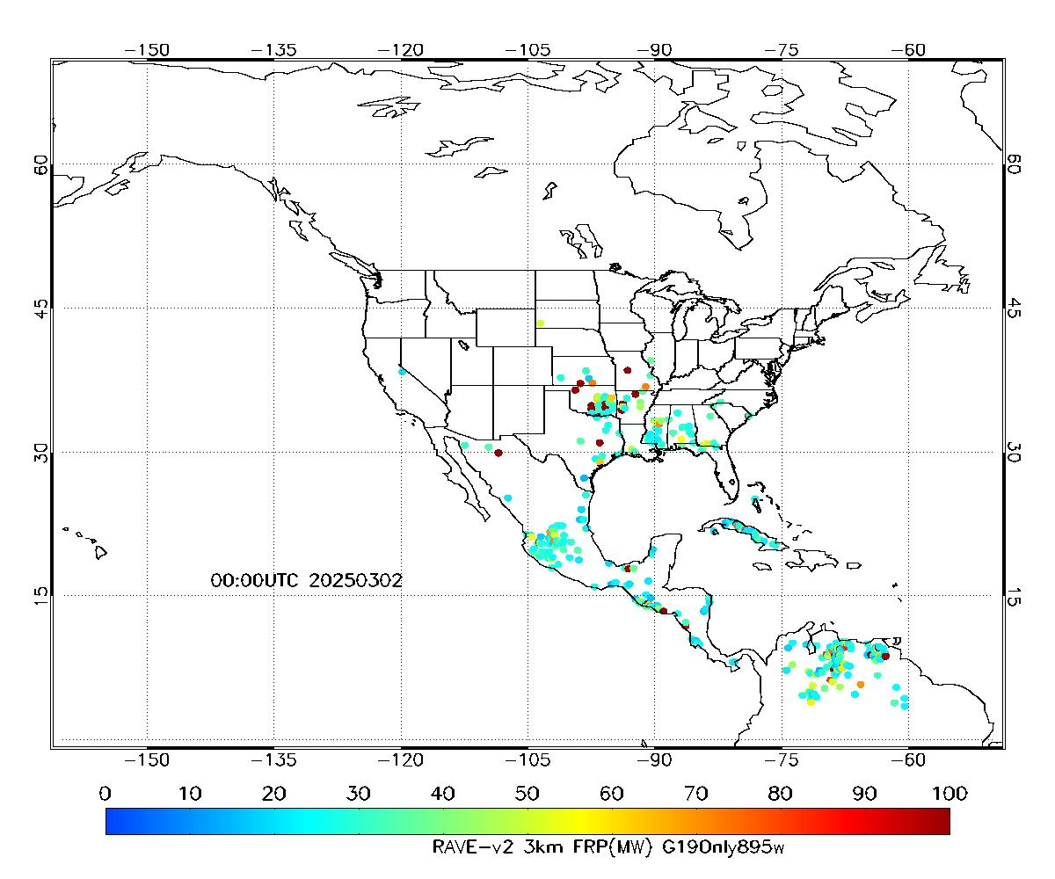
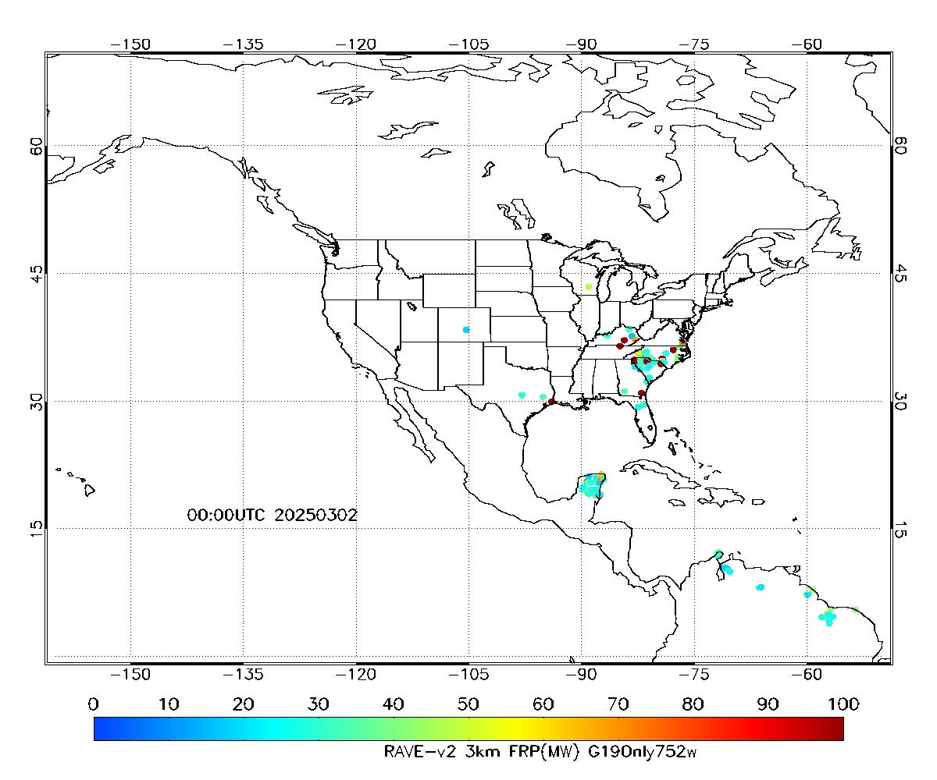
Control experiments to investigation for the difference of FRP from RAVE algorithm on March 2, 2025
Control-1: G16+G18+N20+N21
Control-2: G19+G18+N20+N21
Control-3:
Only G16-75.2W
Control-4:
Only G19-89.5W
Control-5:
Only G19-75.2W

Slide 2
