Slide 1
The main efforts are focused on retrieving Fire Radiative Power (FRP) from the NASA FIREX-AQ FireSense-2023 Level 1B radiance data for the period from October 16 to November 21, 2023. Some preliminary analyses have been completed, and updated FRP and fire mask images have been generated.
Per the request of the NSF UCAR group, three months of reprocessed GBBEPx v5 data (for the period May–July 2023) have been collected and uploaded to the FTP site for use in the group’s modeling experiments.
Some efforts have been made to regenerate and refill missing images for the JstarMapper and AerosolWatch websites as part of ongoing maintenance. Due to IDL license issues and network instability, many layer images were missing between May 10 and 11, 2025. Listed below are missing images and backfilled on both websites.
3.1 For JstarMapper: TROPOMI CO, AI and NO2 images are missing on May 10 and 11. TROPOMI AI image on May 15 is missing;
3.2 For AerosolWatch :
May 10 (1) All VIIRS layers completely or partially missing, including daily PM2.5
(2) All ABI layers have huge gaps.
(3)TROPOMI CO missing on AerosolWatch
(4) TROPOMI CO, NO2, and AI missing on JSTAR Mapper
May 11
(1) All ABI layers missing prior to ~16:40
(2) G19 CONUS AOD missing all day

Slide 2
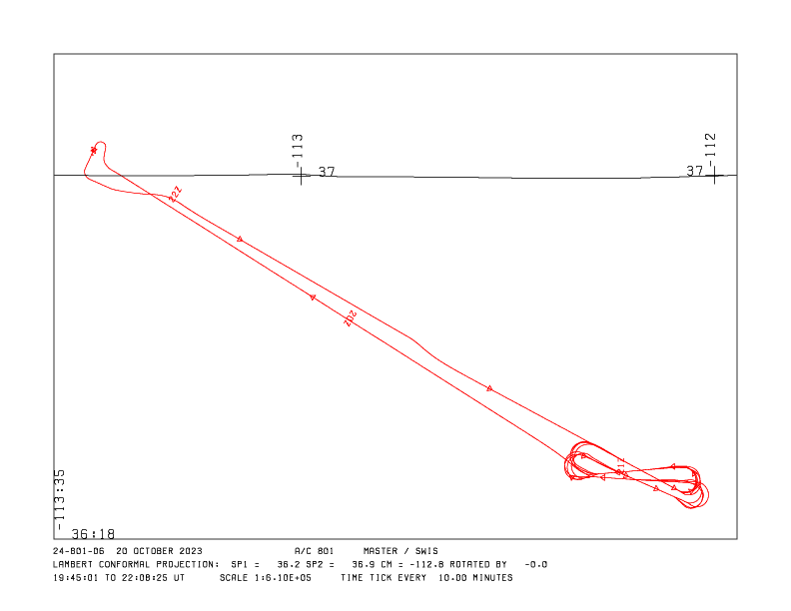
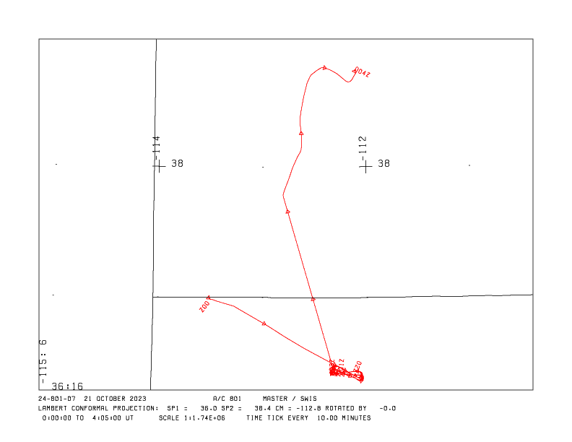
FIREX-AQ FireSense 2023 Experiment data: Examples
Flight path

Slide 3
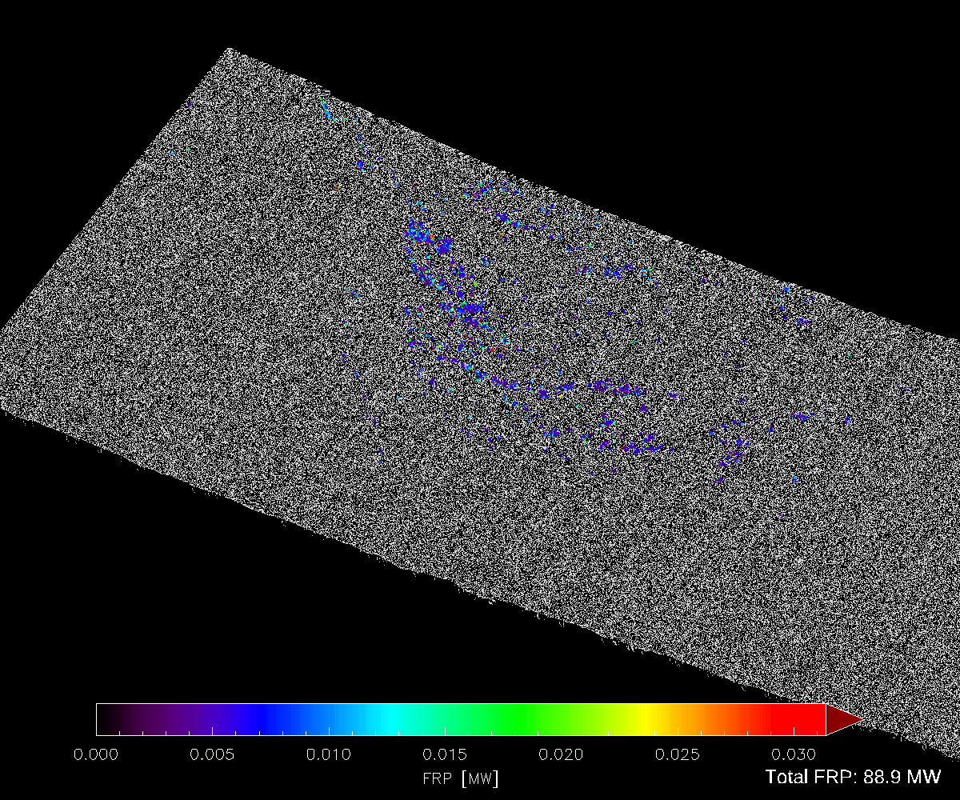
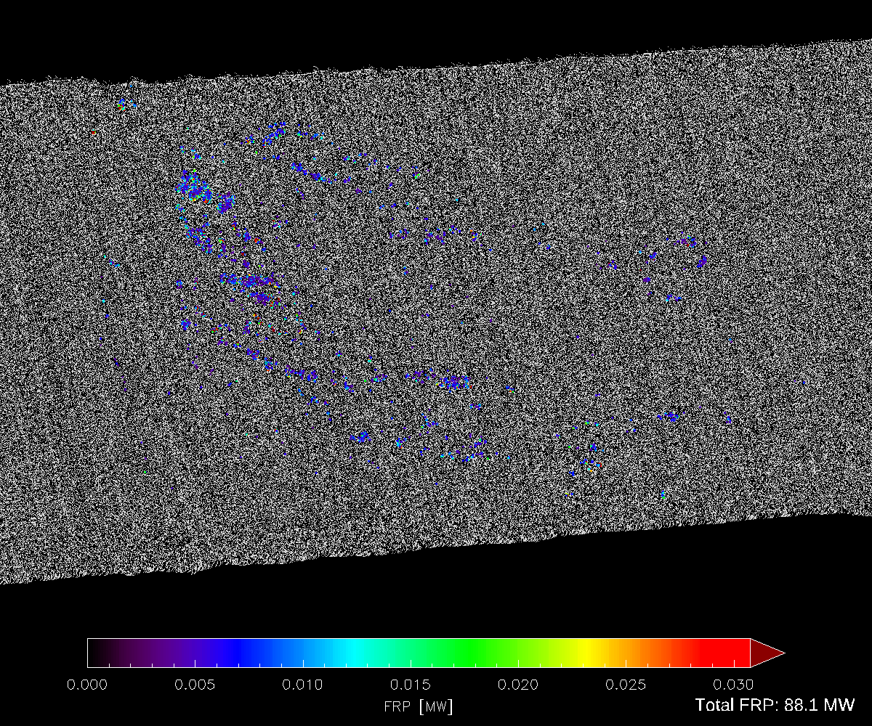
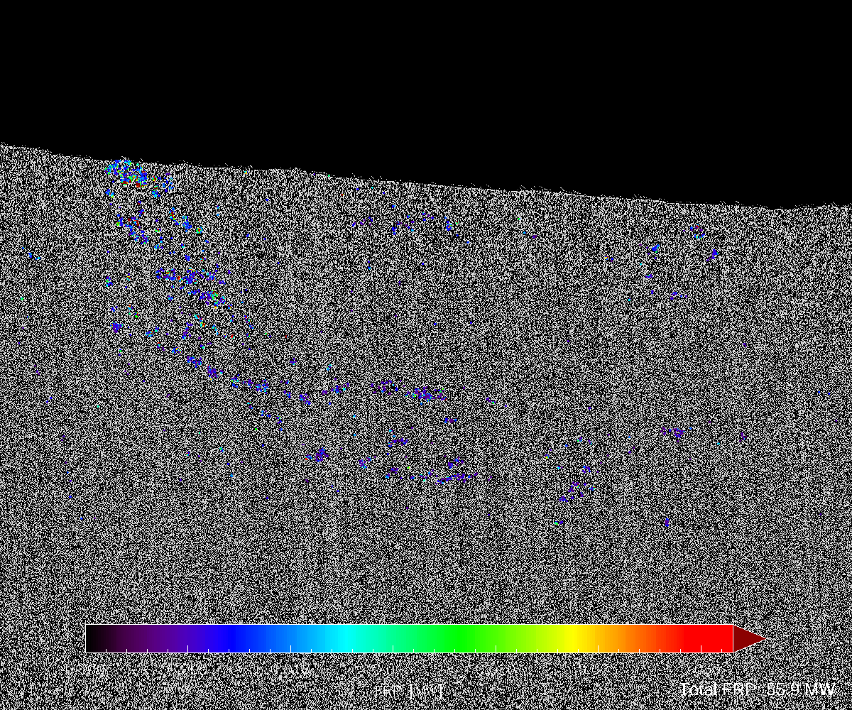
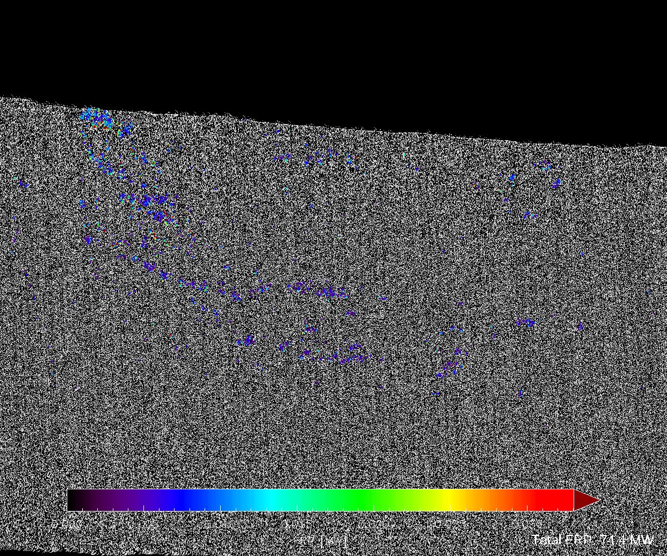
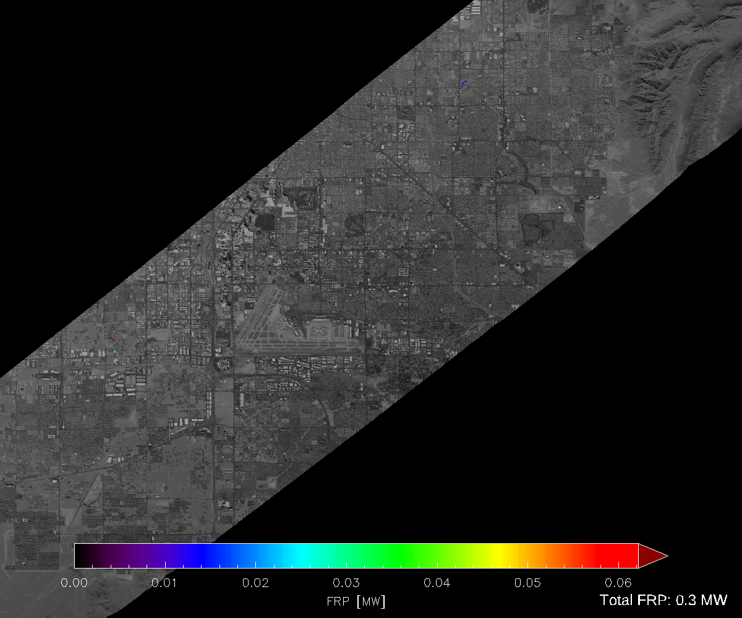
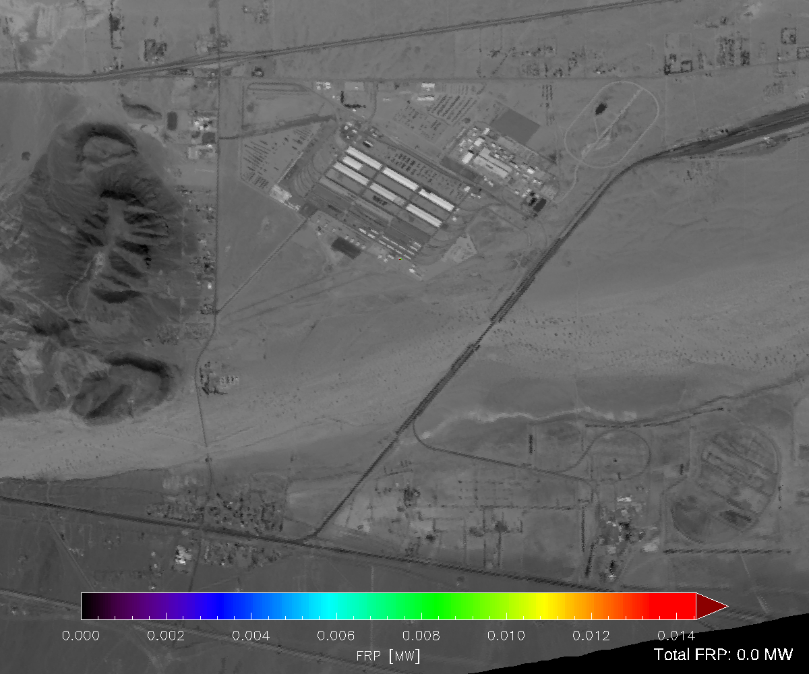
FRP

Slide 4
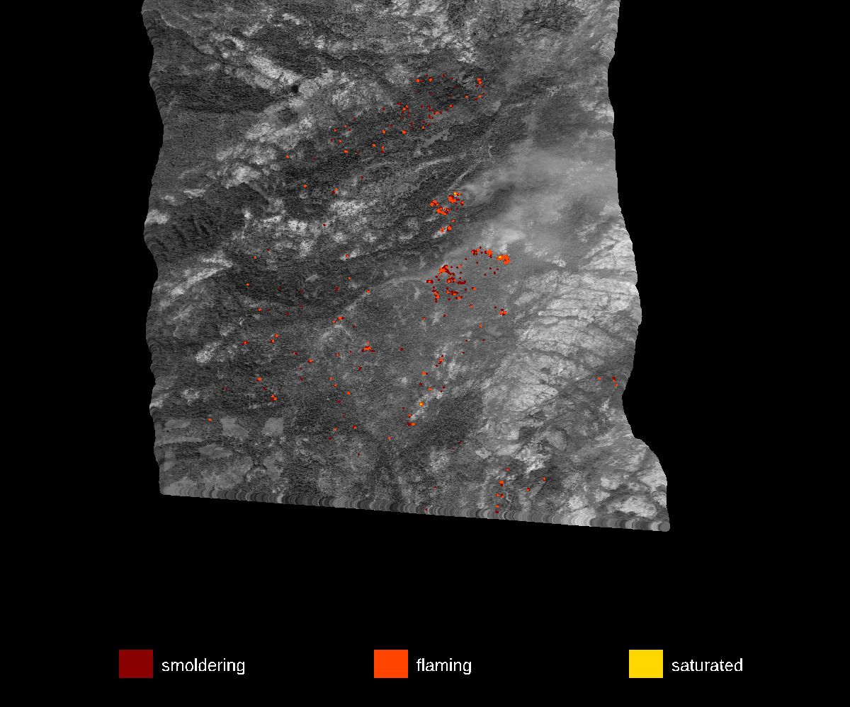
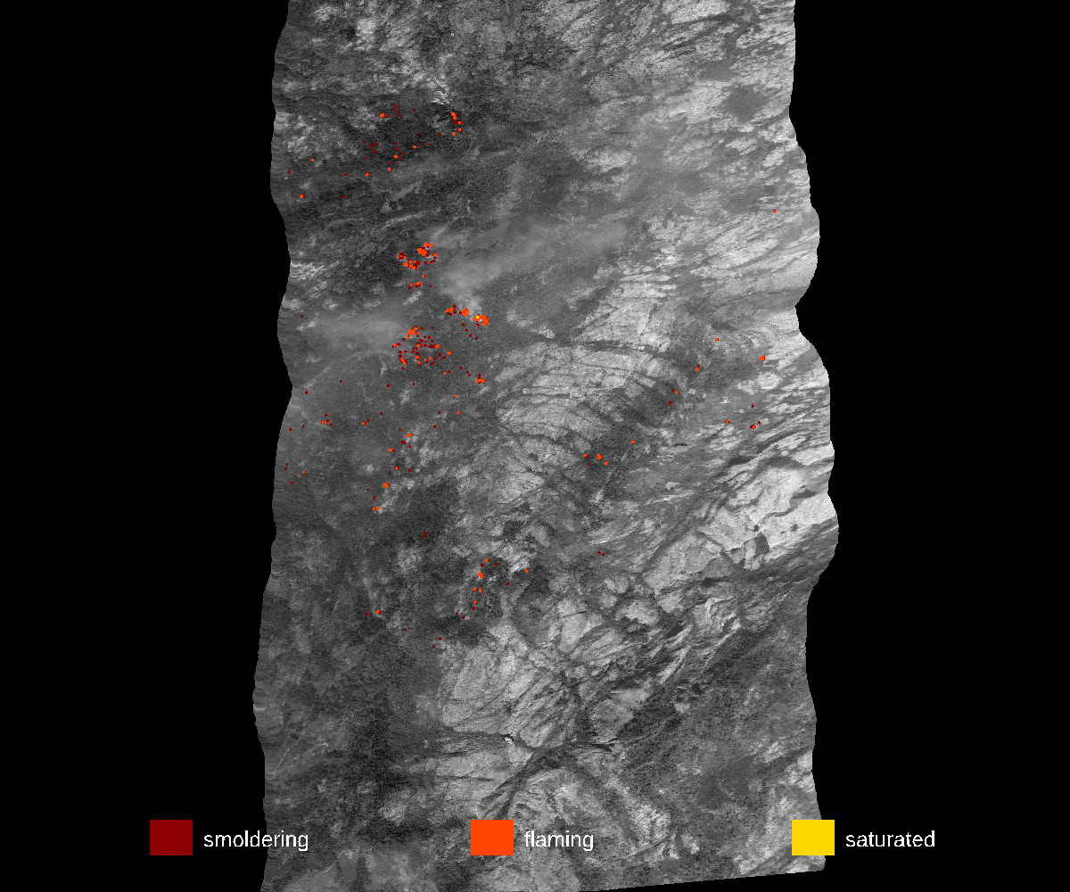
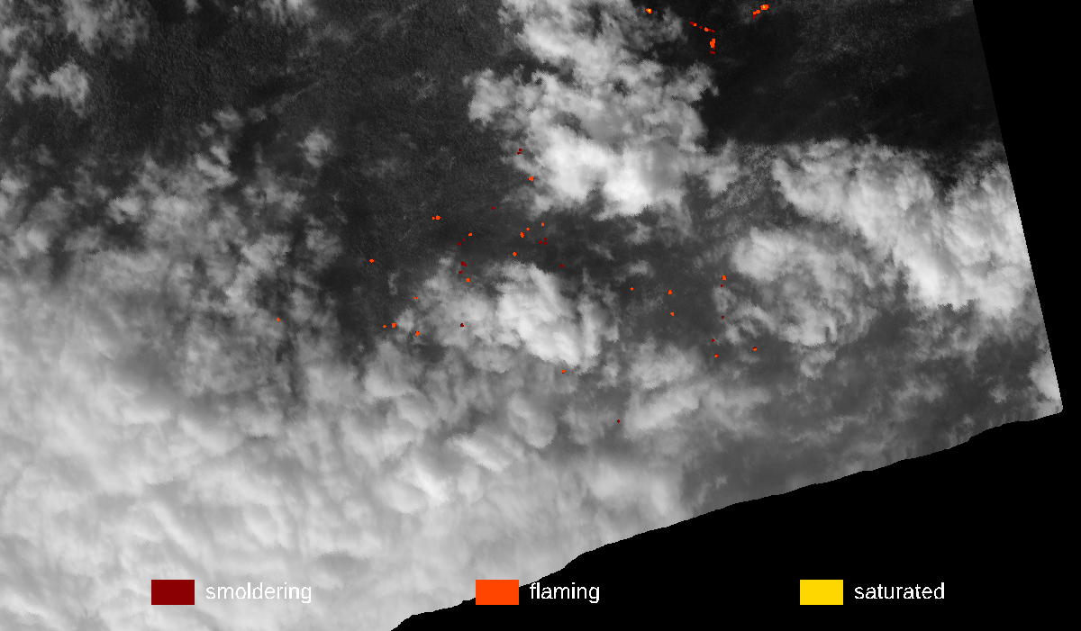
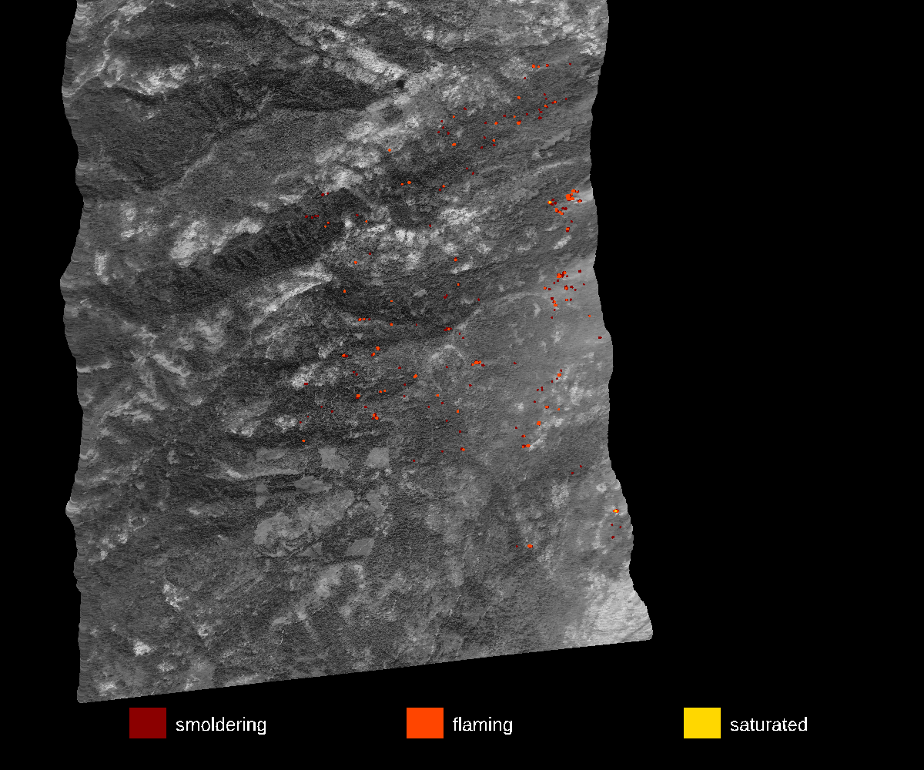
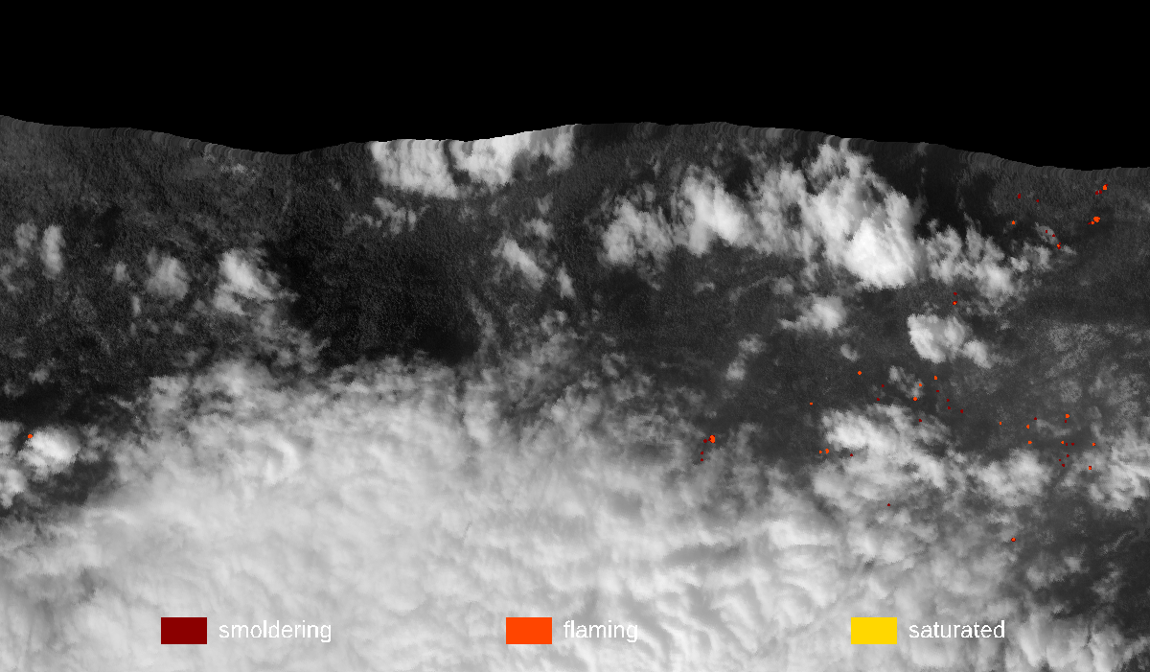
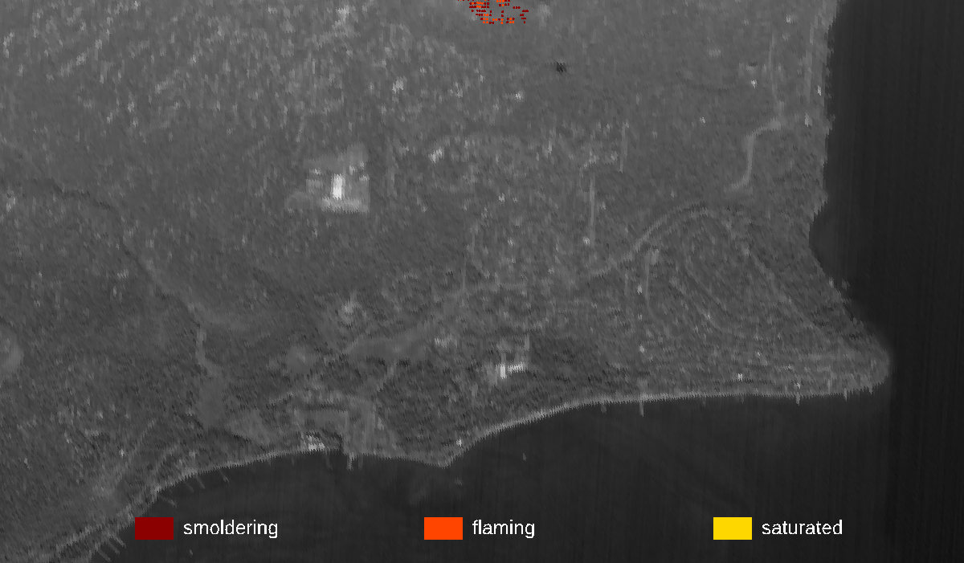
Fire Mask

