Slide 1
Improved SWIR Algorithm Other Cases

Slide 2
La Plata River Estuary from NOAA-20 on Apr.30, 2025

Slide 3
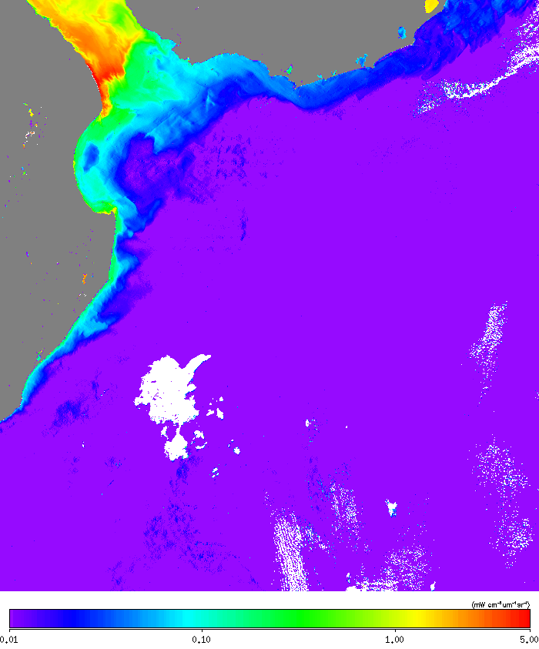
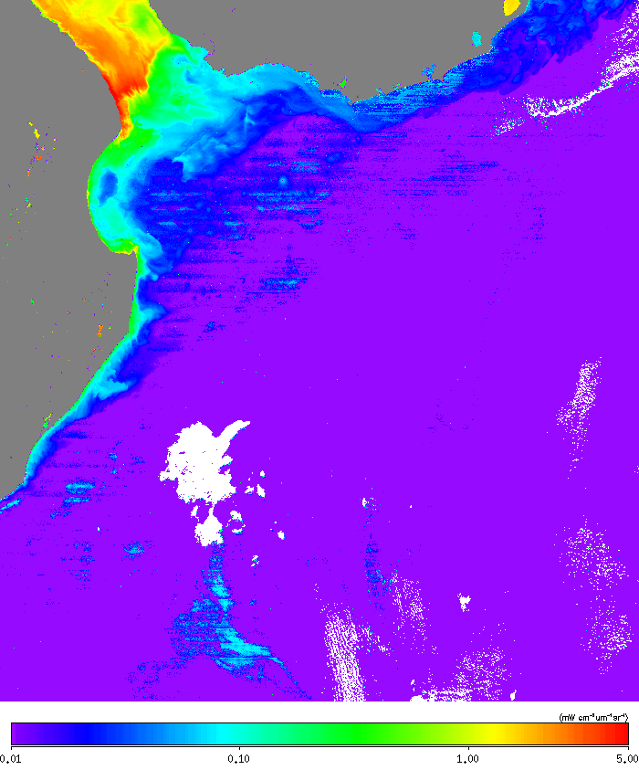
Original SCI (operational)
nLw(868)
Improved SCI1
nLw(868)

Slide 4

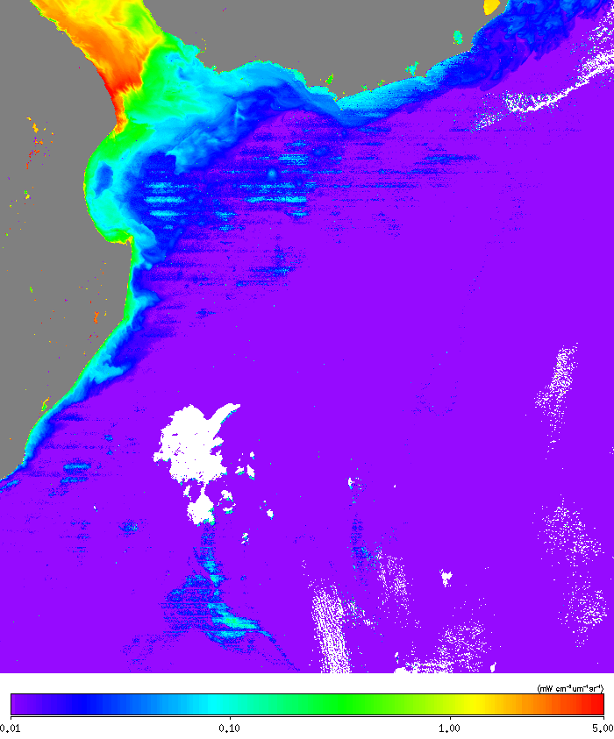
Improved SCI2
nLw(868)
Improved SCI3
nLw(868)

Slide 5
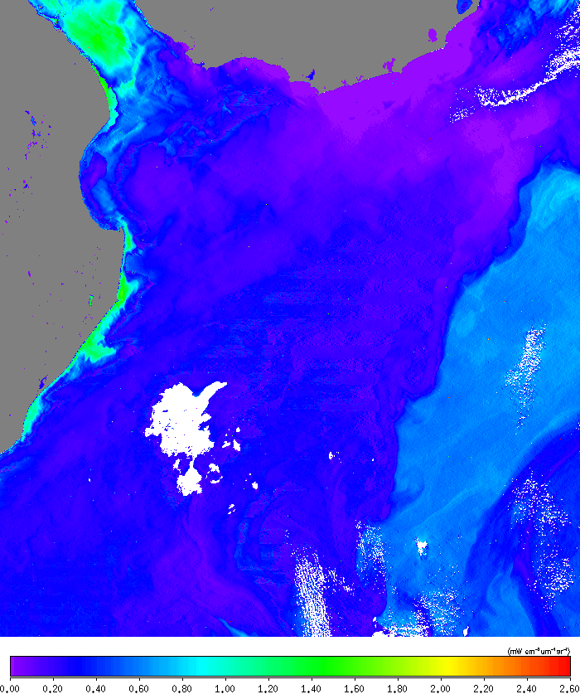
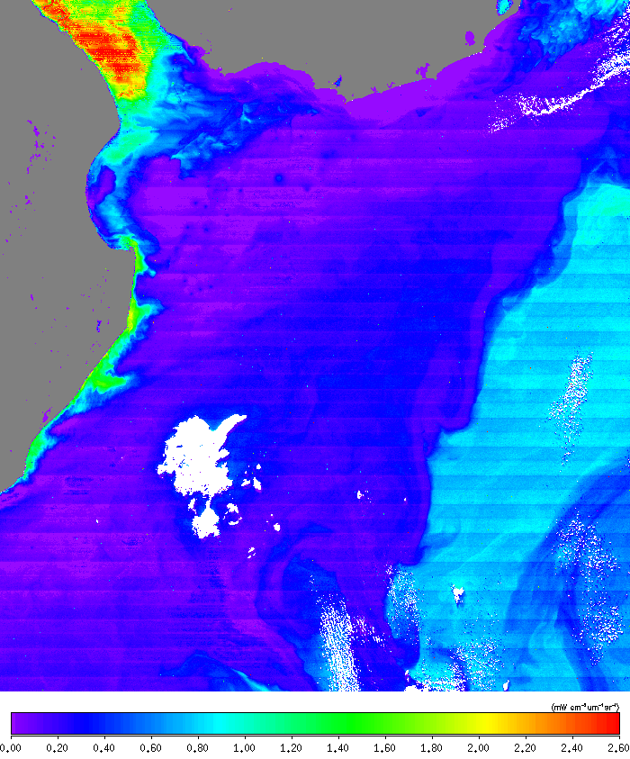
Original SCI (operational)
nLw(411)
Improved SCI1
nLw(411)

Slide 6
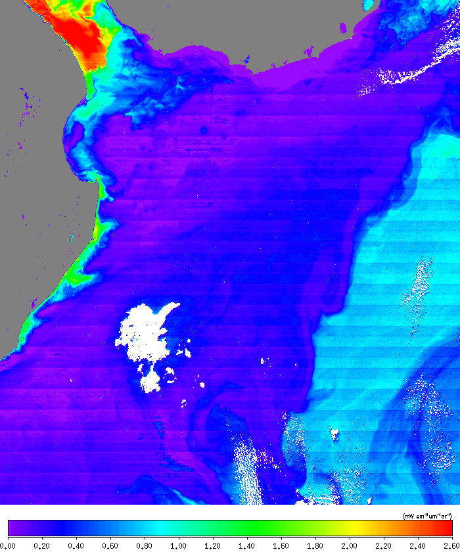

Improved SCI2
nLw(411)
Improved SCI3
nLw(411)

Slide 7
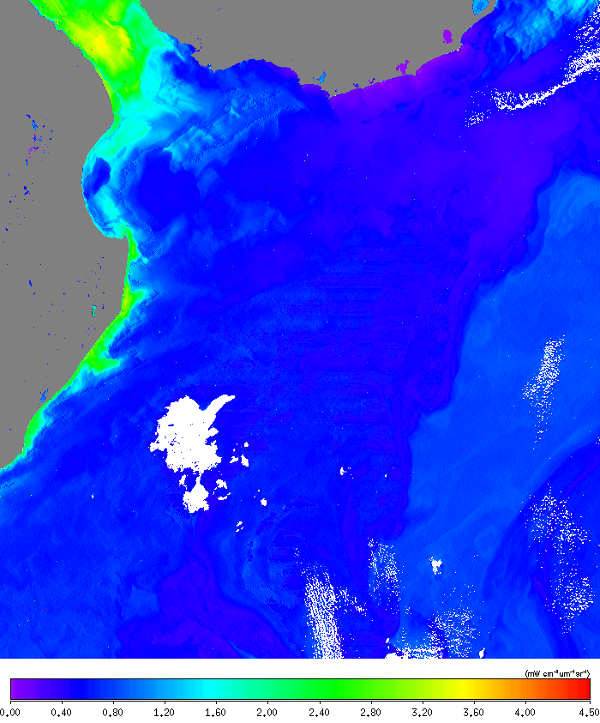
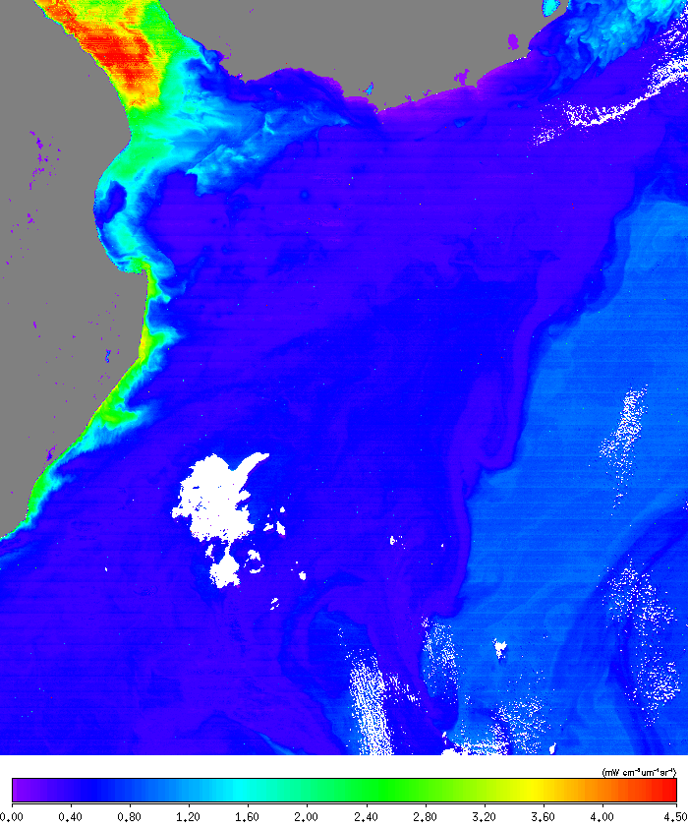
Original SCI (operational)
nLw(445)
Improved SCI1
nLw(445)

Slide 8
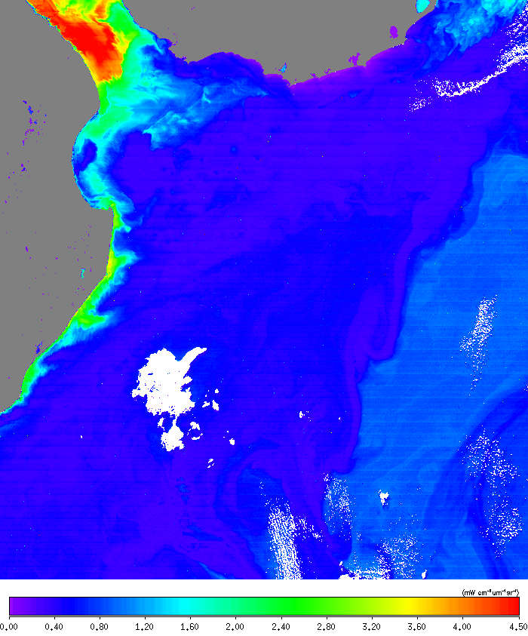

Improved SCI2
nLw(445)
Improved SCI3
nLw(445)

Slide 9
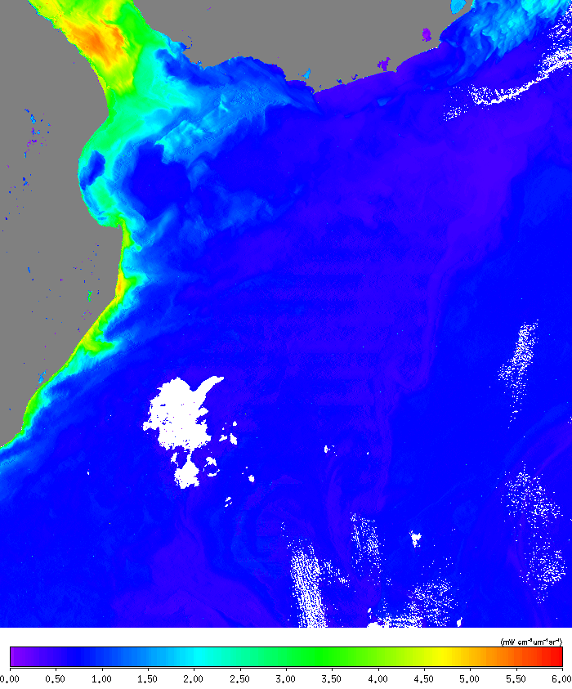
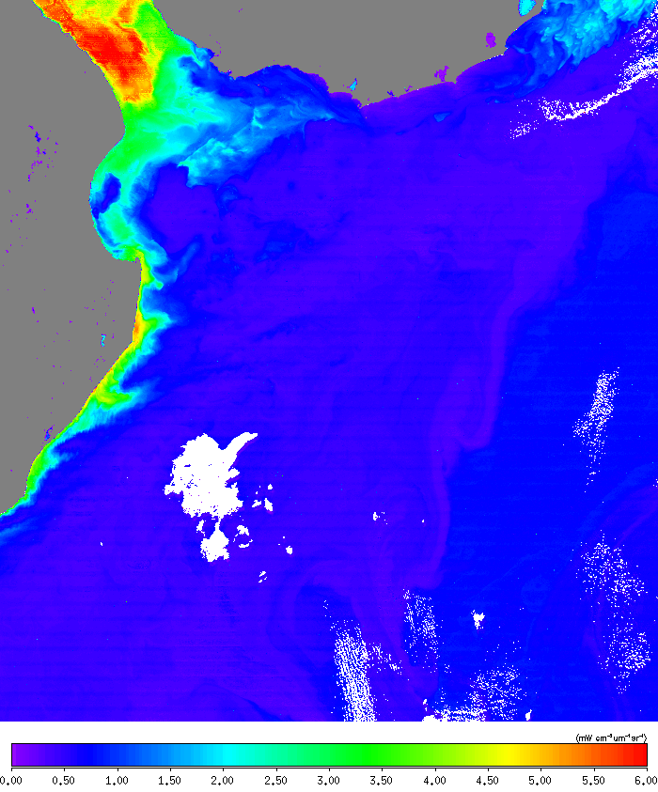
Original SCI (operational)
nLw(489)
Improved SCI1
nLw(489)

Slide 10
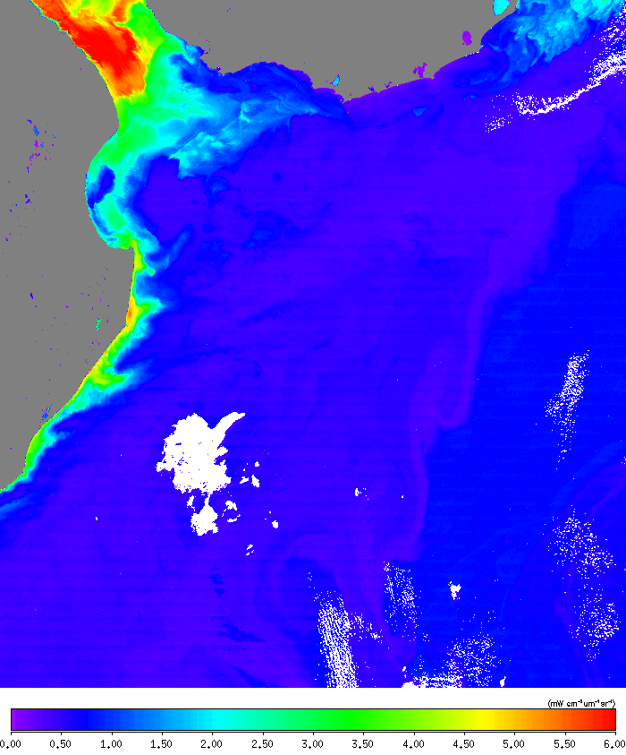

Improved SCI2
nLw(489)
Improved SCI3
nLw(489)

Slide 11
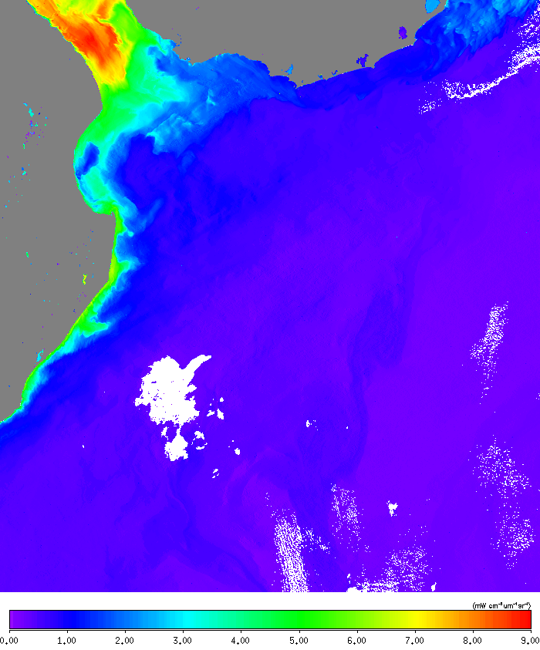
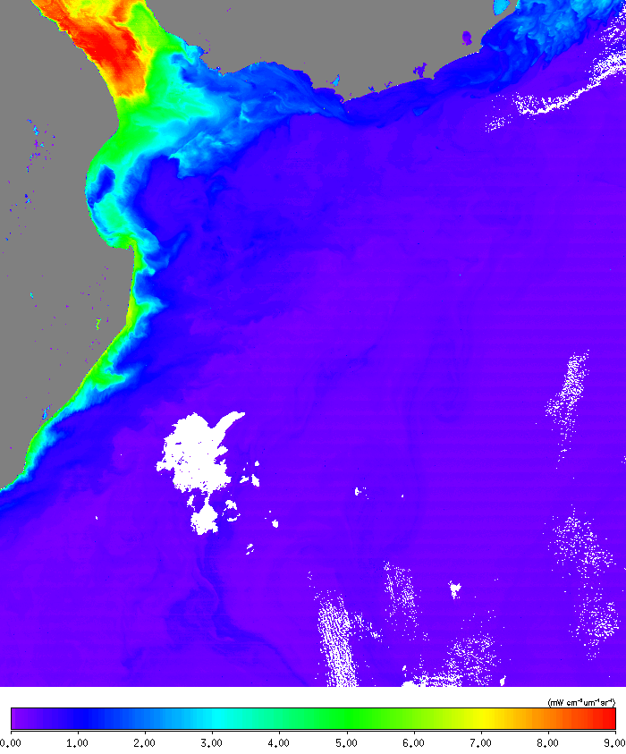
Original SCI (operational)
nLw(556)
Improved SCI1
nLw(556)

Slide 12
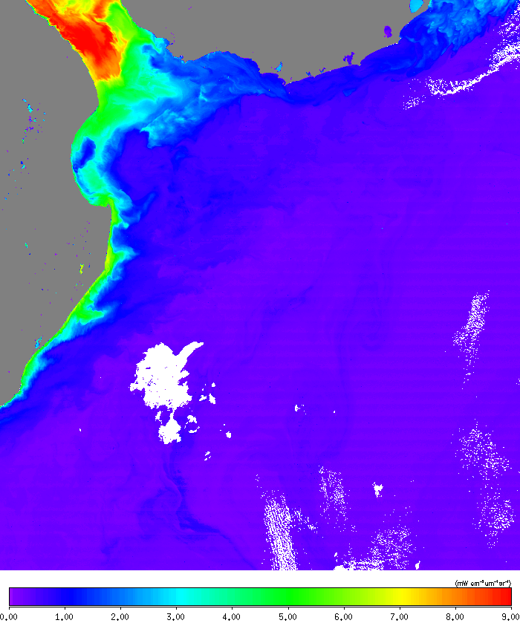

Improved SCI2
nLw(556)
Improved SCI3
nLw(556)

Slide 13
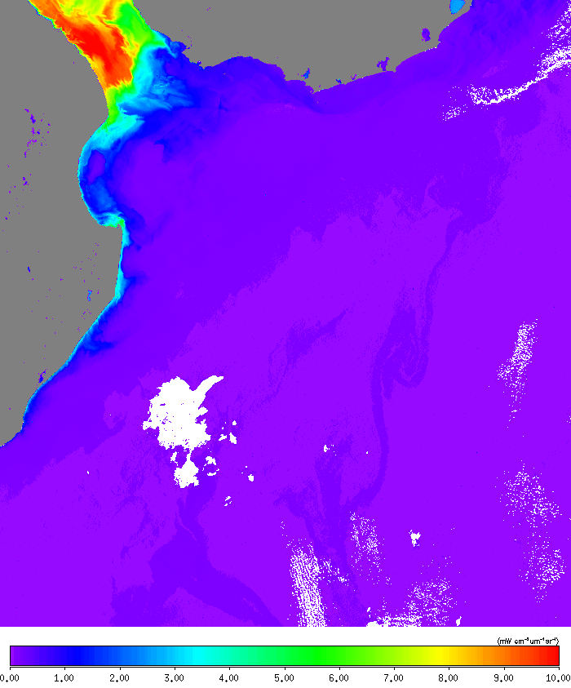

Original SCI (operational)
nLw(667)
Improved SCI1
nLw(667)

Slide 14


Improved SCI2
nLw(667)
Improved SCI3
nLw(667)

Slide 15
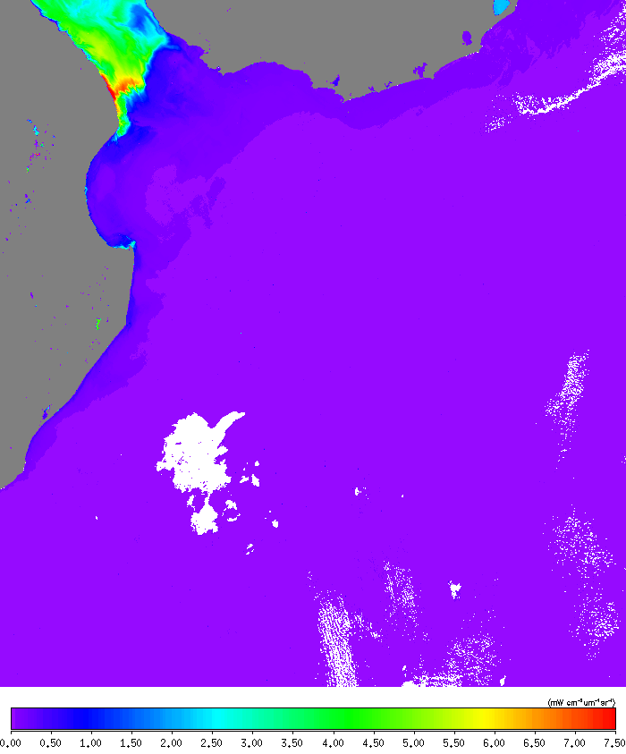

Original SCI (operational)
nLw(746)
Improved SCI1
nLw(746)

Slide 16


Improved SCI2
nLw(746)
Improved SCI3
nLw(746)

Slide 17
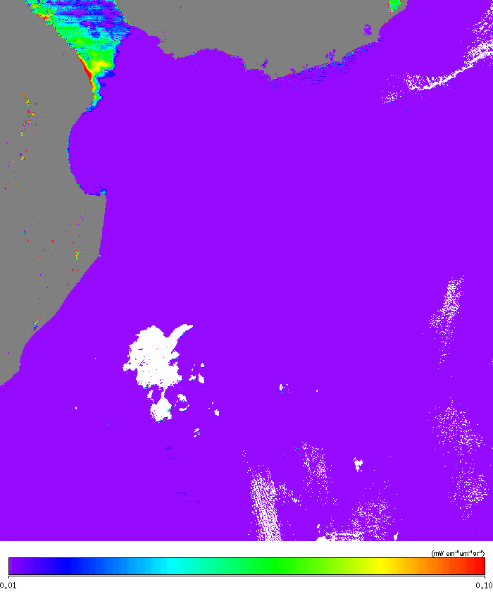
Original SCI (operational)
nLw(1238)
Improved SCI1
nLw(1238)
ASSUMED BLACK !

Slide 18
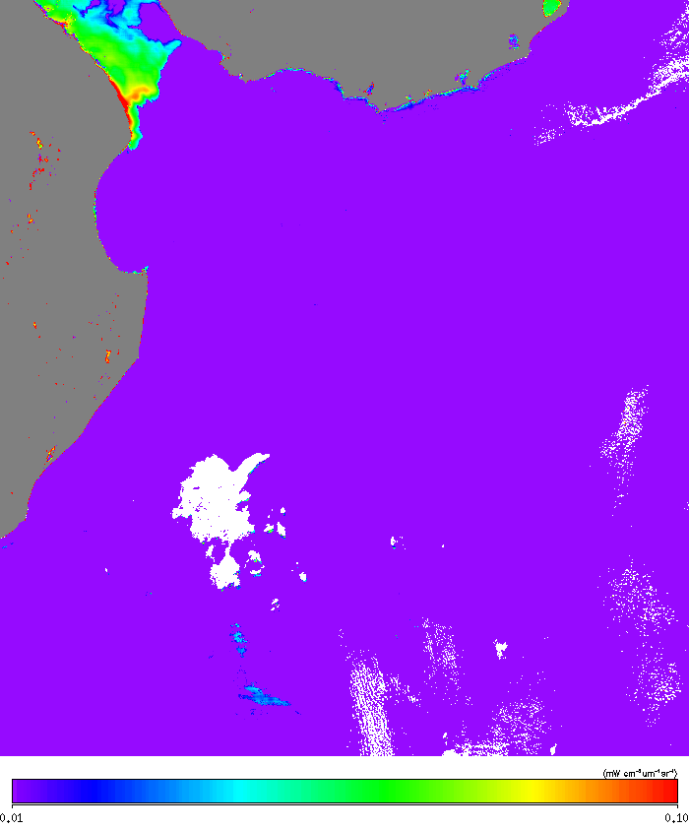
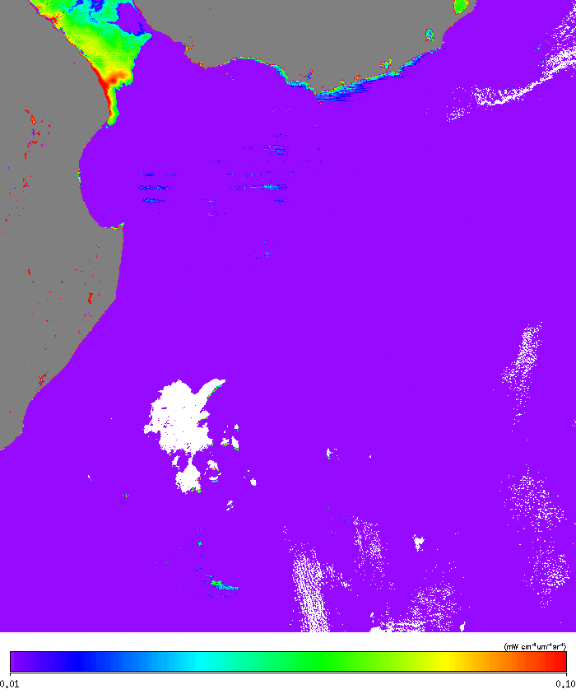
Improved SCI2
nLw(1238)
Improved SCI3
nLw(1238)

Slide 19
Amazon River Estuary from NOAA-20 on Apr.30, 2025

Slide 20
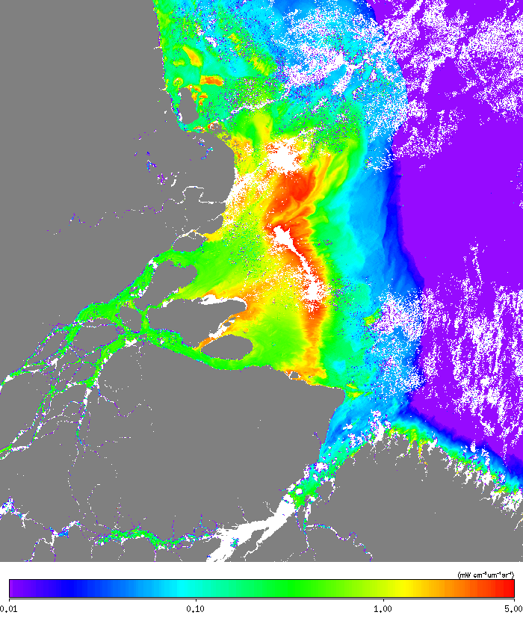
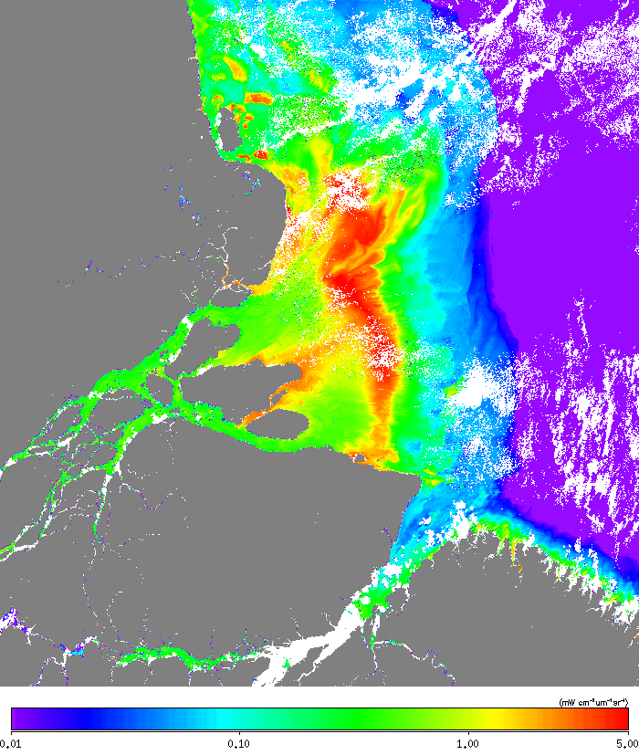
Original SCI (operational)
nLw(868)
Improved SCI1
nLw(868)

Slide 21


Improved SCI2
nLw(868)
Improved SCI3
nLw(868)

Slide 22
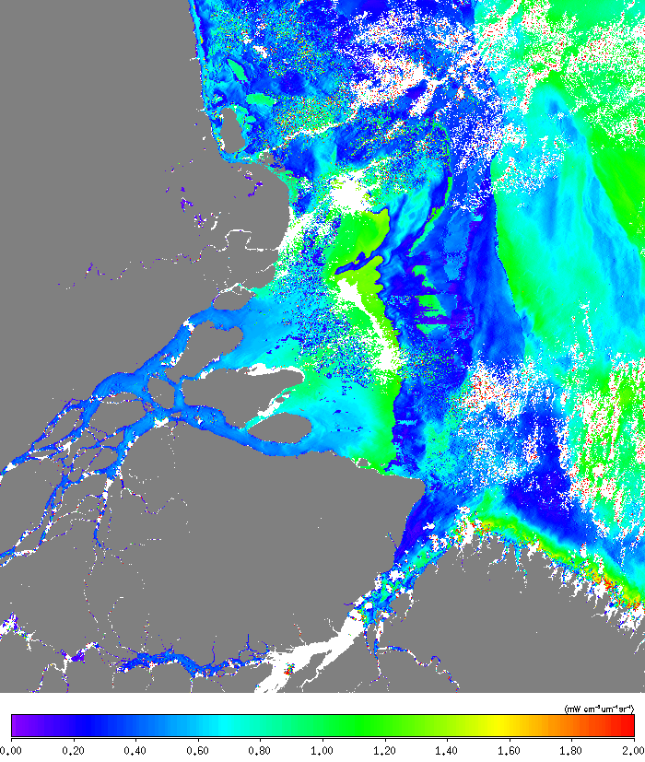
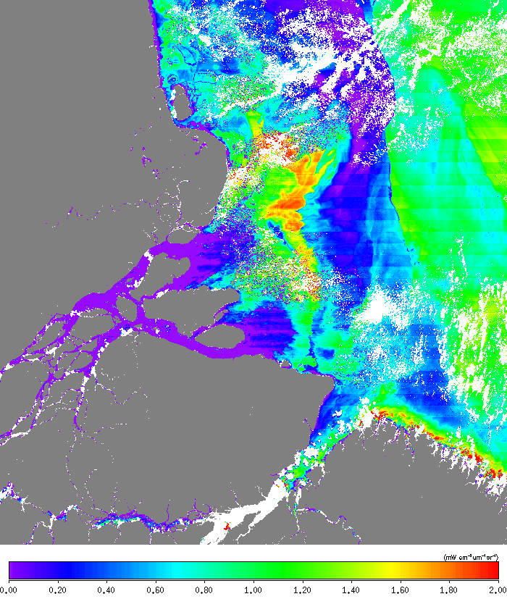
Original SCI (operational)
nLw(411)
Improved SCI1
nLw(411)

Slide 23
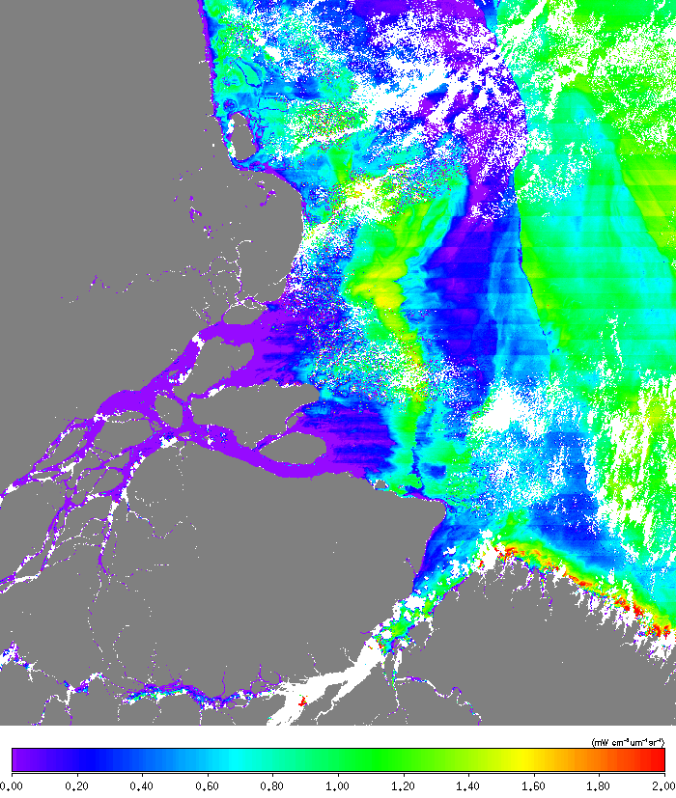

Improved SCI2
nLw(411)
Improved SCI3
nLw(411)

Slide 24
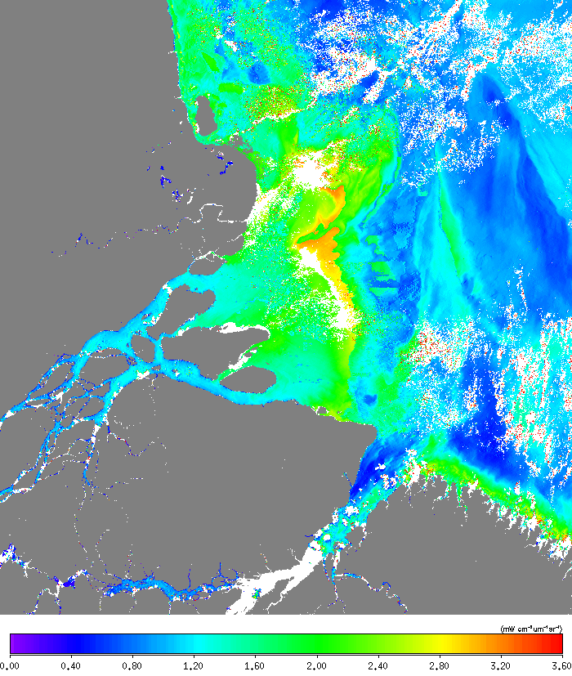
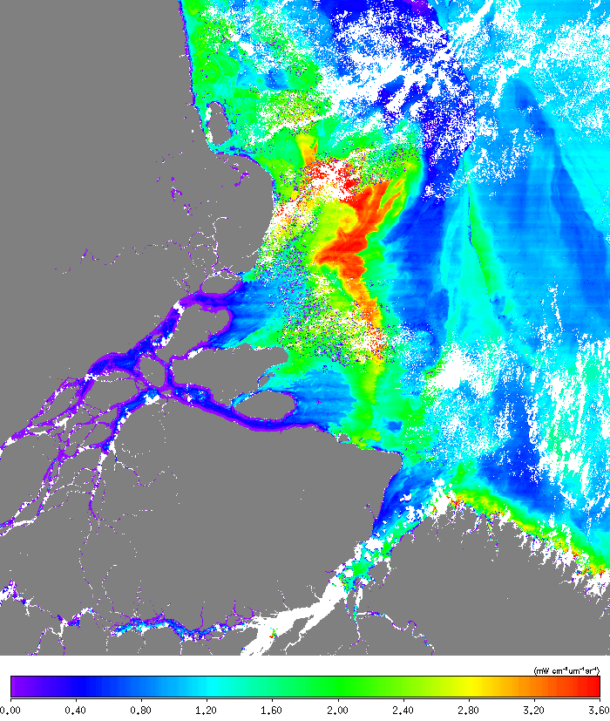
Original SCI (operational)
nLw(445)
Improved SCI1
nLw(445)

Slide 25
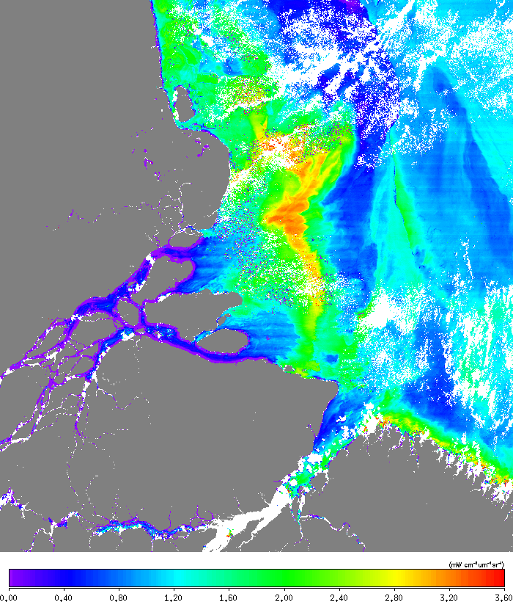
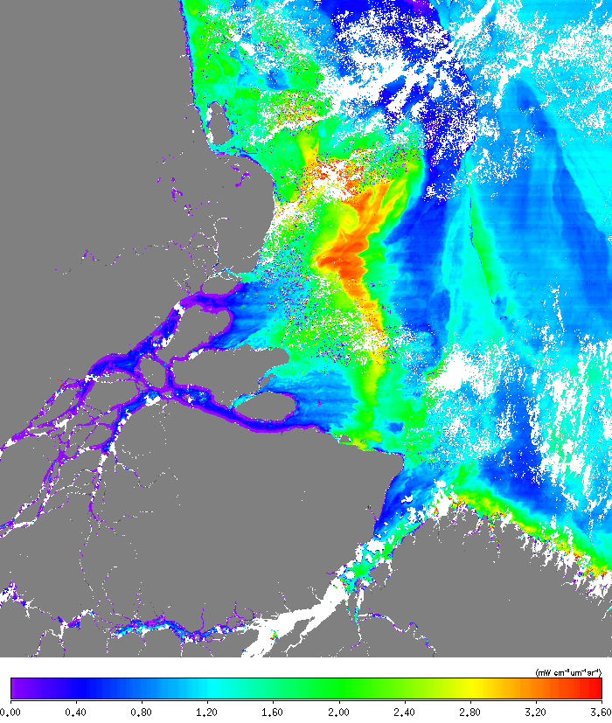
Improved SCI2
nLw(445)
Improved SCI3
nLw(445)

Slide 26
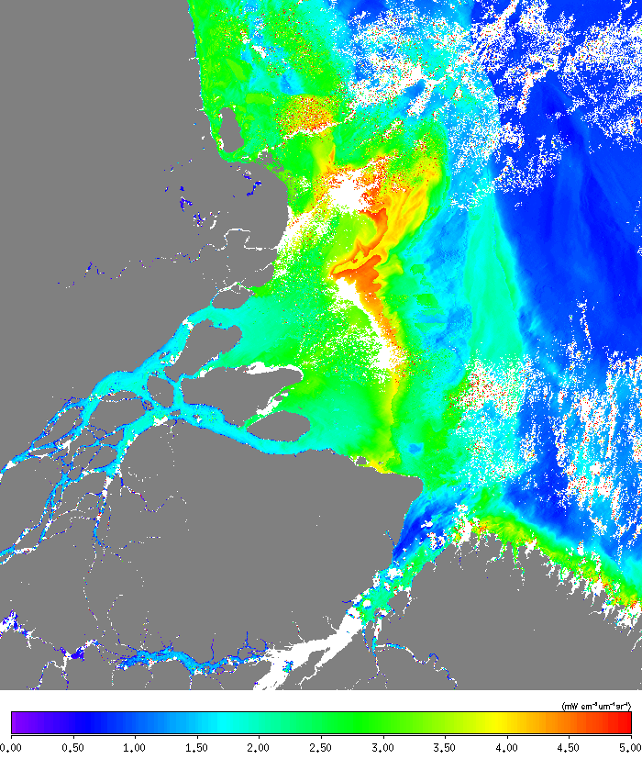
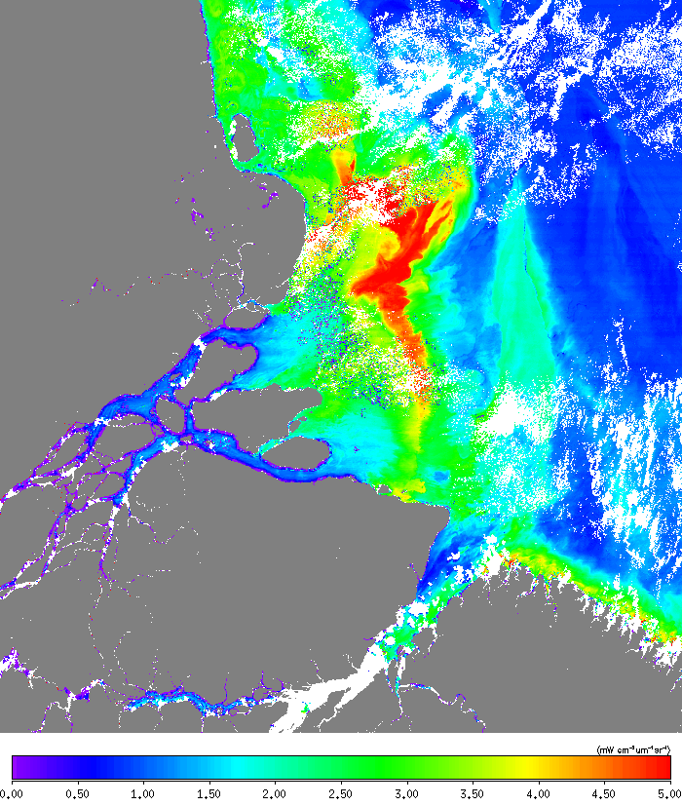
Original SCI (operational)
nLw(489)
Improved SCI1
nLw(489)

Slide 27
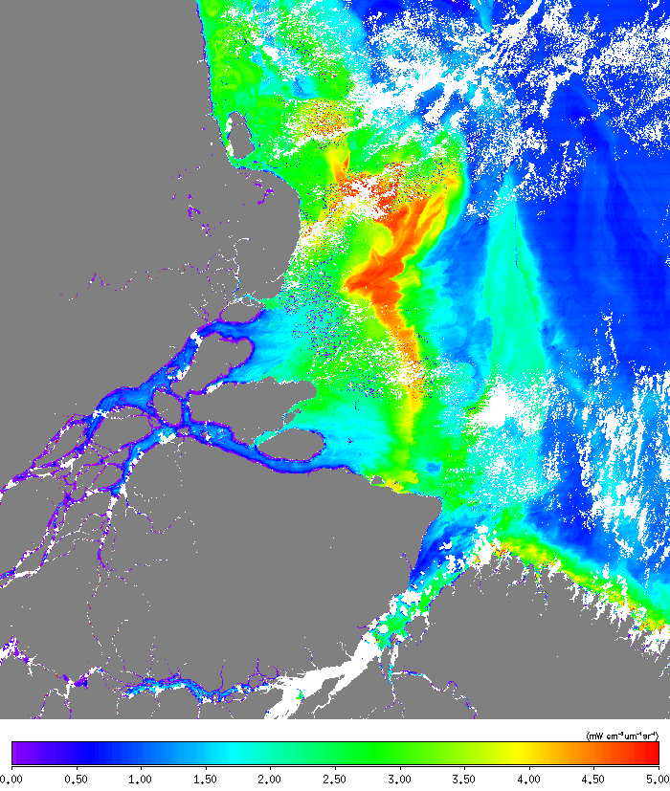
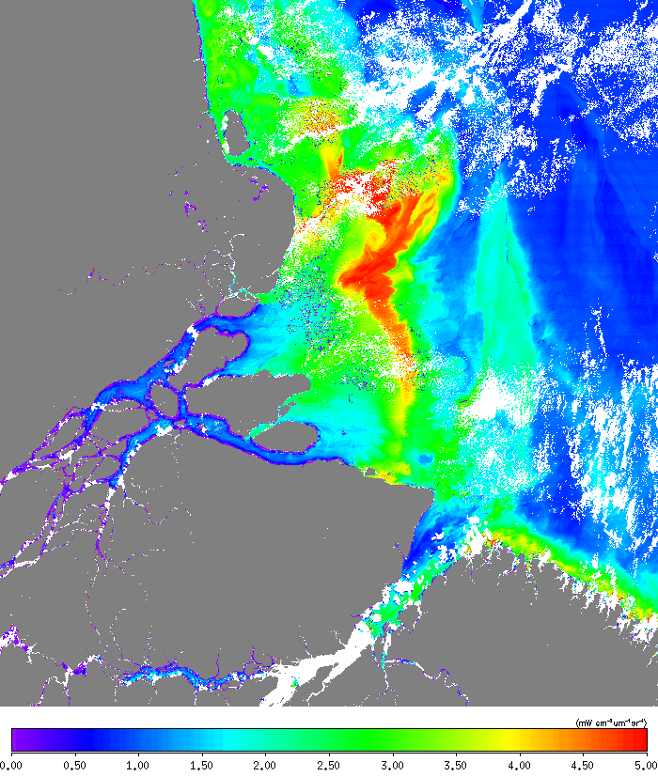
Improved SCI2
nLw(489)
Improved SCI3
nLw(489)

Slide 28
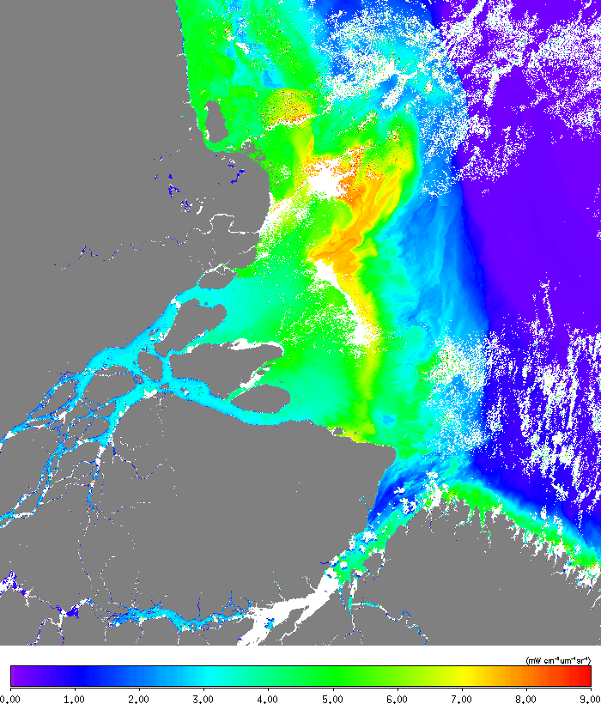
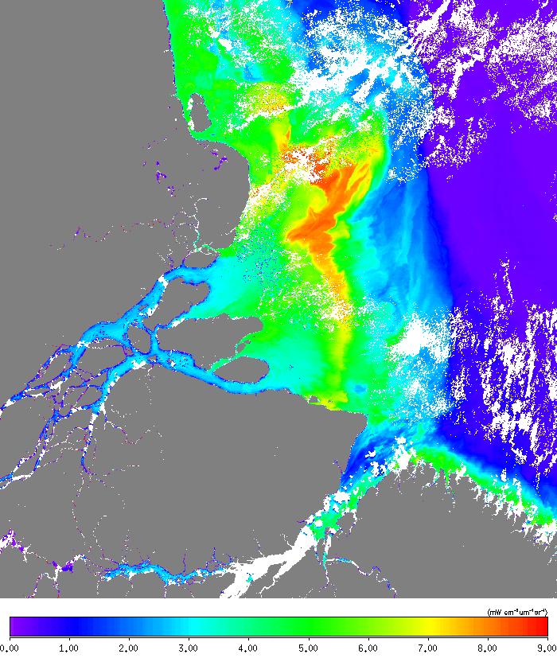
Original SCI (operational)
nLw(556)
Improved SCI1
nLw(556)

Slide 29
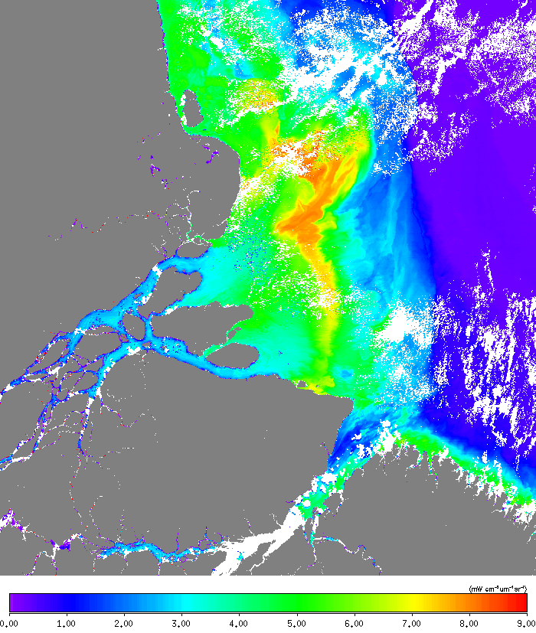

Improved SCI2
nLw(556)
Improved SCI3
nLw(556)

Slide 30
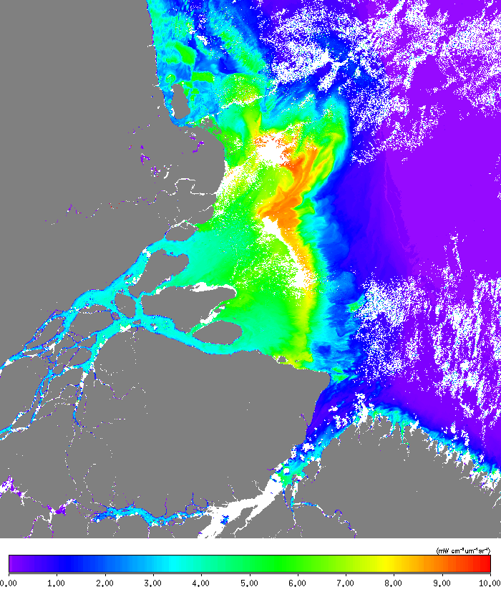
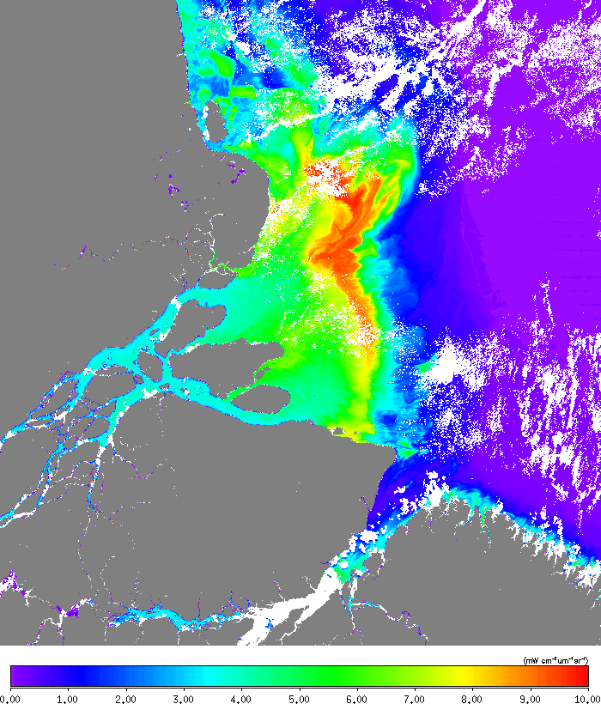
Original SCI (operational)
nLw(667)
Improved SCI1
nLw(667)

Slide 31


Improved SCI2
nLw(667)
Improved SCI3
nLw(667)

Slide 32
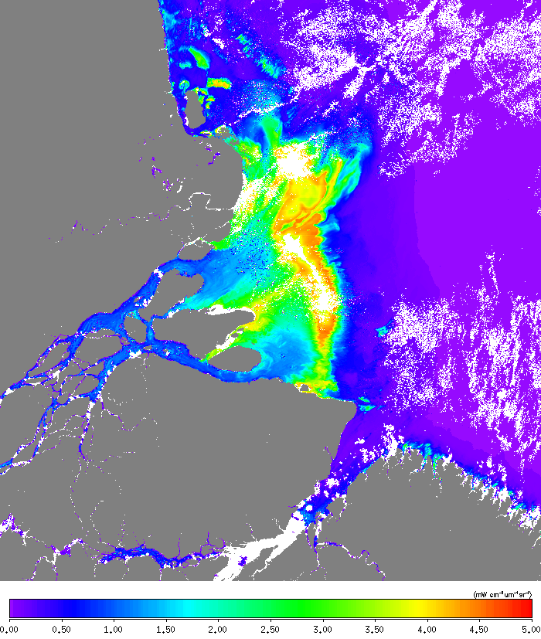
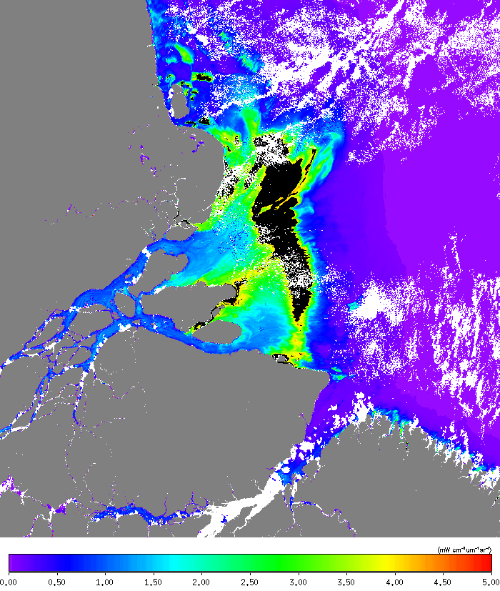
Original SCI (operational)
nLw(746)
Improved SCI1
nLw(746)

Slide 33
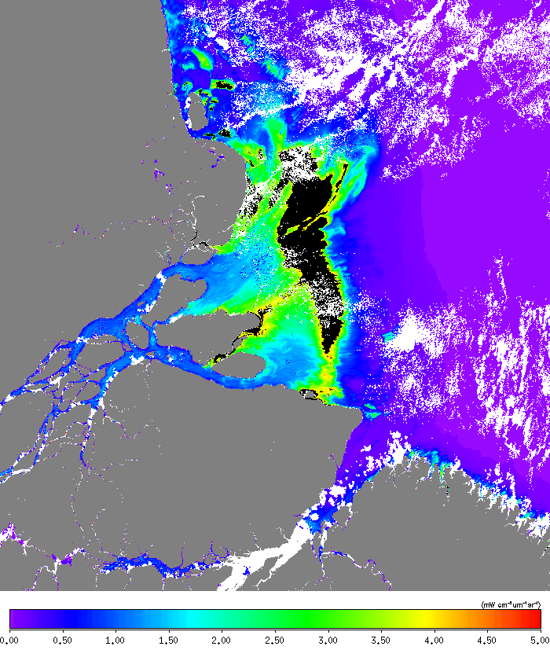

Improved SCI2
nLw(746)
Improved SCI3
nLw(746)

Slide 34
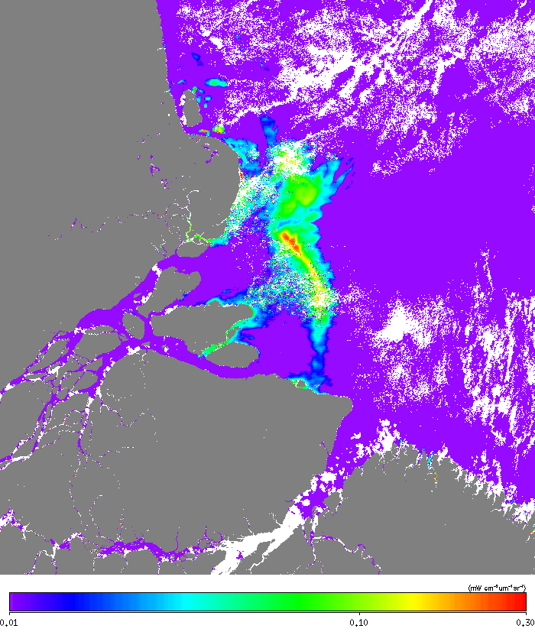
Original SCI (operational)
nLw(1238)
Improved SCI1
nLw(1238)
ASSUMED BLACK !

Slide 35
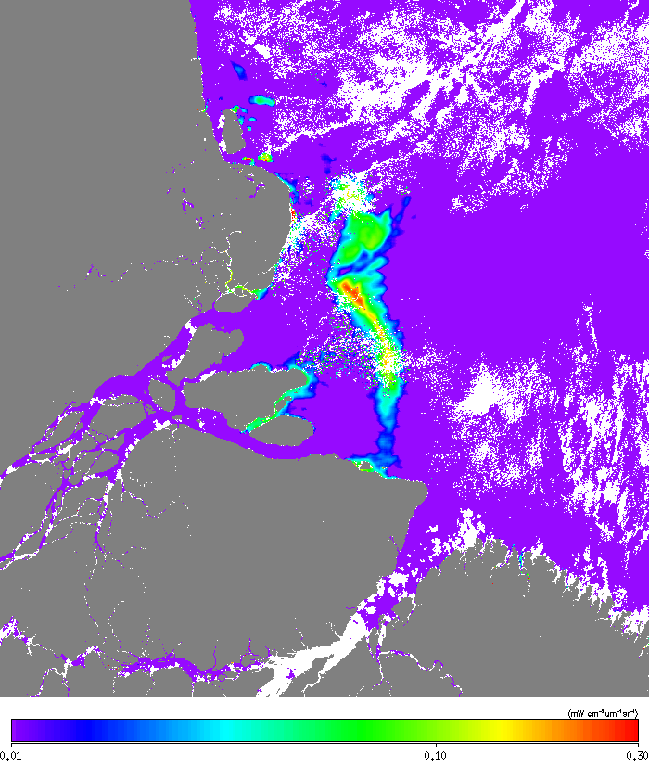
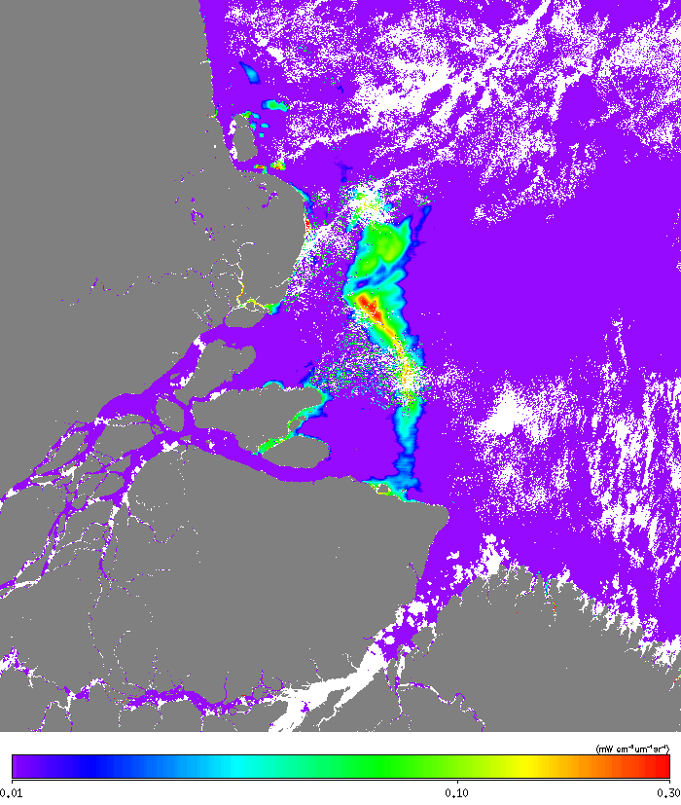
Improved SCI2
nLw(1238)
Improved SCI3
nLw(1238)

Slide 36
Yellow Sea Algae Bloom from SNPP on Jun.25, 2016

Slide 37
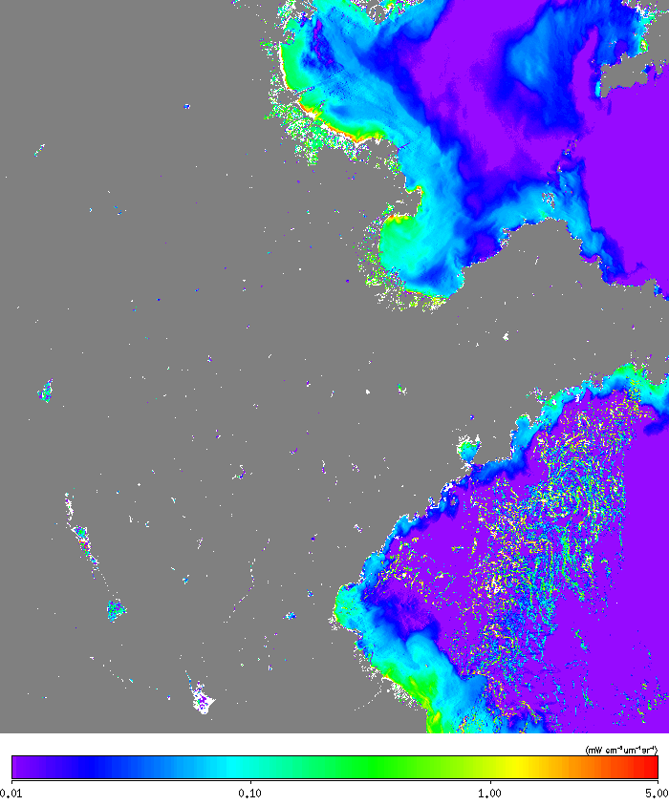
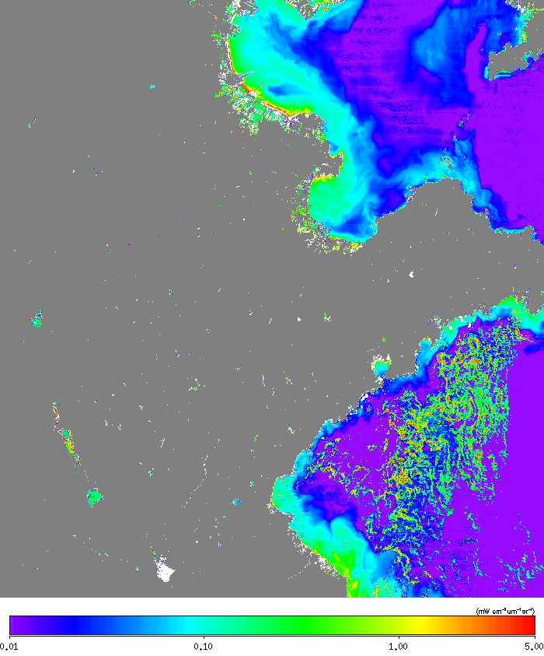
Original SCI (operational)
nLw(862)
Improved SCI1
nLw(862)

Slide 38


Improved SCI2
nLw(862)
Improved SCI3
nLw(862)

Slide 39
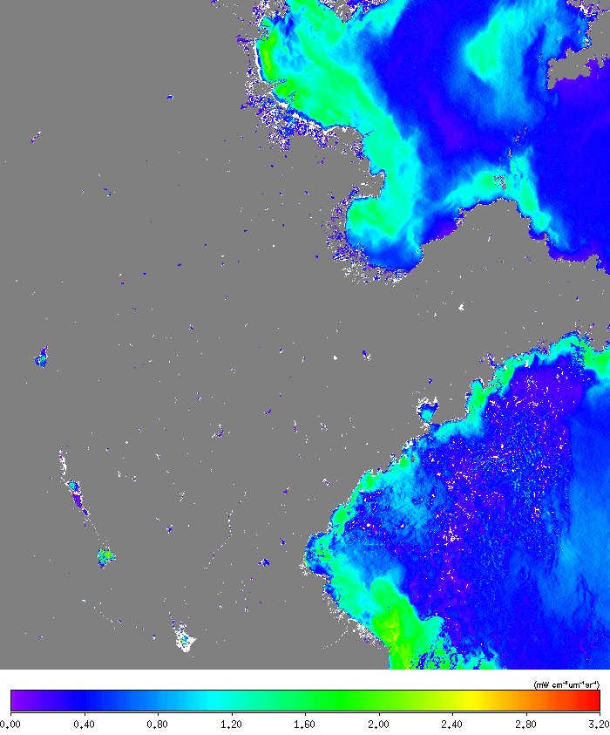
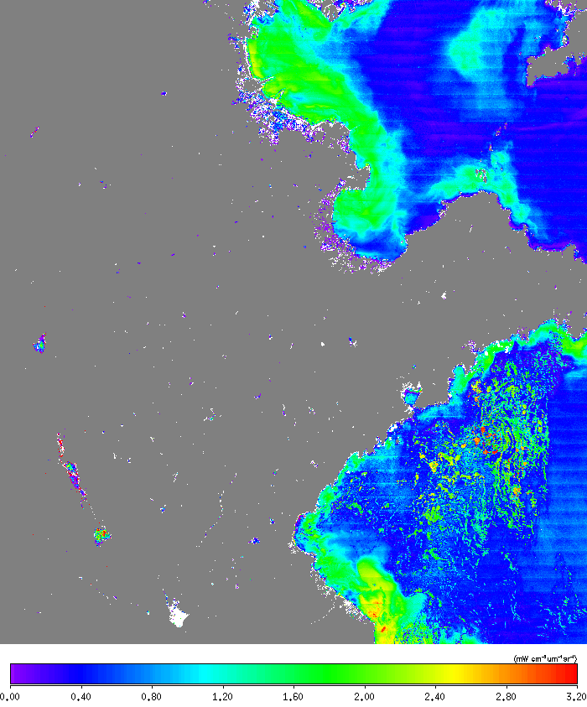
Original SCI (operational)
nLw(410)
Improved SCI1
nLw(410)

Slide 40
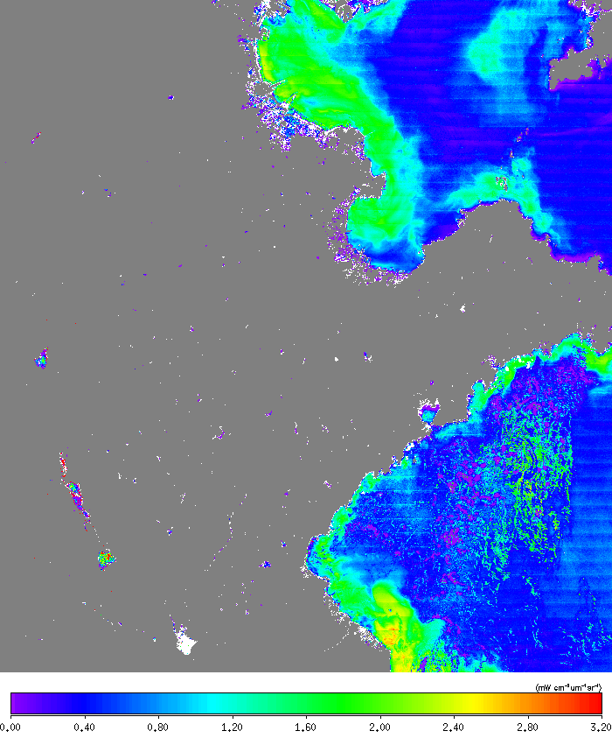

Improved SCI2
nLw(410)
Improved SCI3
nLw(410)

Slide 41
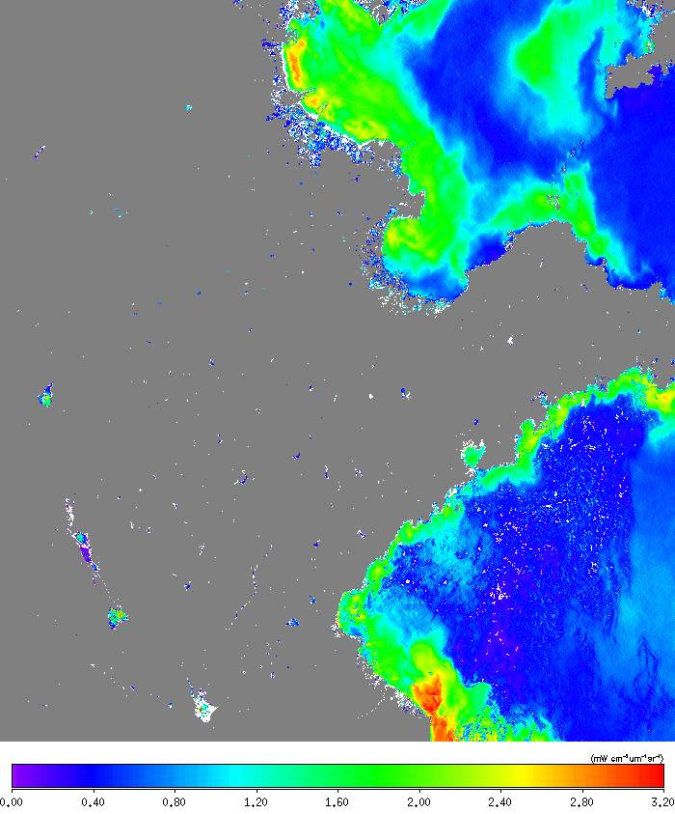

Original SCI (operational)
nLw(443)
Improved SCI1
nLw(443)

Slide 42


Improved SCI2
nLw(443)
Improved SCI3
nLw(443)

Slide 43


Original SCI (operational)
nLw(486)
Improved SCI1
nLw(486)

Slide 44


Improved SCI2
Improved SCI2
nLw(486)
nLw(486)
Improved SCI3

Slide 45


Original SCI (operational)
nLw(551)
Improved SCI1
nLw(551)

Slide 46


Improved SCI2
Improved SCI2
nLw(551)
nLw(551)
Improved SCI3

Slide 47


Original SCI (operational)
nLw(671)
Improved SCI1
nLw(671)

Slide 48


Improved SCI2
Improved SCI2
nLw(671)
nLw(671)
Improved SCI3

Slide 49


Original SCI (operational)
nLw(745)
Improved SCI1
nLw(745)

Slide 50


Improved SCI2
Improved SCI2
nLw(745)
nLw(745)
Improved SCI3

Slide 51

Original SCI (operational)
nLw(1238)
Improved SCI1
nLw(1238)
ASSUMED BLACK !

Slide 52


Improved SCI2
Improved SCI2
nLw(1238)
nLw(1238)
Improved SCI3

